Slide 1

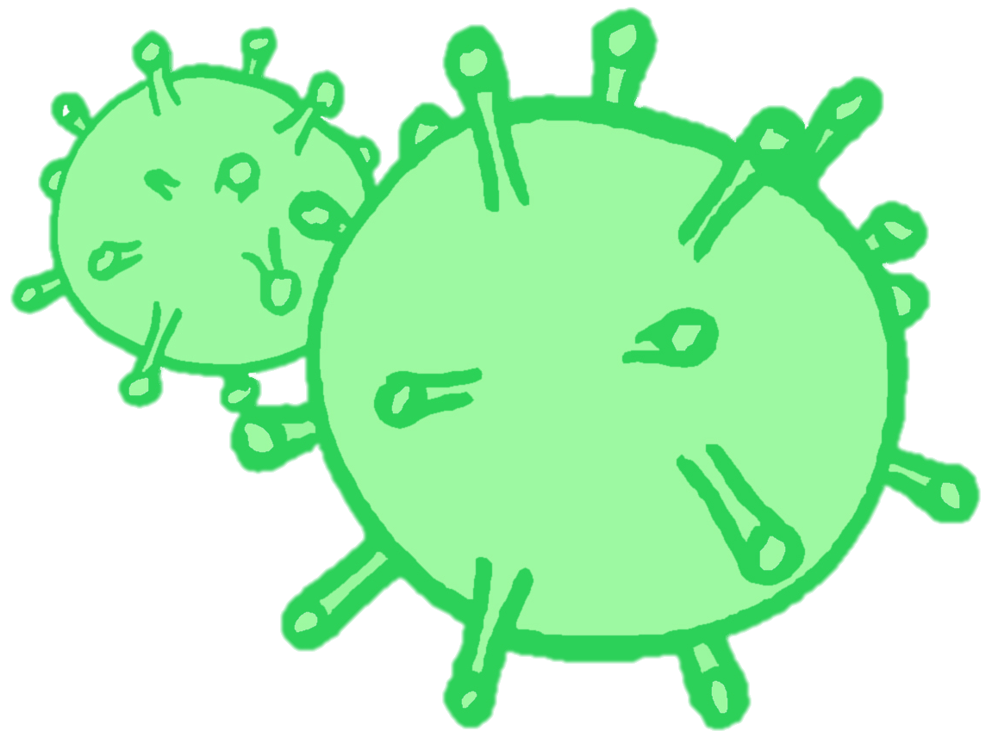
CONTRACEPTION & STI’s
Year 10 Health Lesson 1 Term 2, 2024

Slide 2
Term 2: Program & Assessments
PROGRAM:
Weeks 1 – 4: Contraception.
Weeks 5 – 11: Sexually Transmitted Infections.
ASSESSMENTS:
Assessment Task 2: Topic Test (week 4)
    Contraception
    Consent and the law
    Options for and impact of unplanned pregnancy
Health Attributes.
Assessment Task 3: STI Presentation (weeks 9 – 11)
    Contributes to semester 2 reports.
TERM 1 content
Notes:
Discuss this slide and the upcoming assessment tasks.

Slide 3

Today’s Focus
Review consent.
Introduction to contraception.

Slide 4
ACTIVITY 1: CONSENT REVIEW – BRAINSTORM (pg. 8)
Brainstorm everything you can recall on CONSENT:
  What is it?
  Examples of how to ask for consent.
  How can consent be given?
  When can consent NOT be given?
  Consent and the law.
You have 5 minutes.
CONSENT
Notes:
Relevant to test

Slide 5
REVIEW: What is Consent? (pg. 8)
Consent is…
  Active, not passive.
  The presence of an enthusiastic yes (not the absence of a no).
  An ongoing conversation.
  Respect.
  An agreement freely made, or permission given without coercion, force, threats, manipulation, or intimidation etc.
  Only able to given by those 16 years and above.
Sexual consent is when both partners agree to engage in any kind of sexual behaviours.
It can be withdrawn at ANY time and is only applicable to the specific act at that specific time.
Notes:
Relevant to test
Discuss
Instruct students to add any information they did not have in their brainstorm to their work.

Slide 6
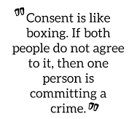
REVIEW: Consent (pg. 8)
Giving consent is active, not passive. This means freely choosing to say 'yes' and also being free to change your mind at any time.
In Western Australia, the legal age for males and females to consent to sexual activity is 16 years of age. If you have sex with someone who is under 16 years of age it is a crime.
Consent can be:
  VERBAL – a clearly, spoken agreement.
  NON-VERBAL – free and active participation.
Notes:
Relevant to test
Discuss
Instruct students to add any information they did not have in their brainstorm to their work.

Slide 7
REVIEW: Consent – freedom and capacity (pg. 8)
FREEDOM to GIVE consent:
  When a person can make the choice to engage in sexual activity freely, free from threats, intimidation or coercion etc.
CAPACITY to GIVE consent:
  Even if consent has been given, they still need to have the CAPACITY to do so.
  People who DO NOT have the CAPACITY to GIVE consent include:
    Anyone under 16 years of age.
    Anyone who is unconscious, asleep, intoxicated, drugged, or otherwise
    unable to say yes.
    Anyone who has a psychological or decision-making disability that impacts on
    their ability to understand what they are consenting to.
If these criteria are not met, and a person is not able to give consent, regardless of age, it is a crime to engage in a sexual relationship or sexual behaviours with that person.
Notes:
Relevant to test (discussed in T1 L7 P.P.)
Discuss
FREEDOM example – if a person has been threatened, black mailed, tricked, coerced, forced, intimidated into having sex → consent cannot be given because the person has not had the freedom to make their own decision, they have been influenced by the other person’s behaviours.

Slide 8
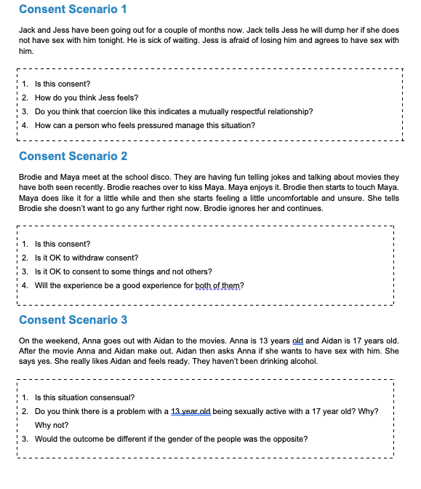
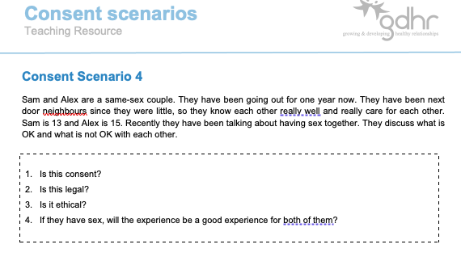
Activity 2: Consent Scenario’s – IS this Consent?
Working in small groups (max. 4 people).
Each group will be given a scenario.
As a group, answer the 4 questions on the card.
Be prepared to share your responses.
You have 5 minutes.
Notes:
OPTIONAL – can also use this as a revision activity.
Resources required – consent scenario cards + teacher information sheet (located in health storeroom).
Students work in groups of 4 max.
Give each group a different scenario.
Allow 5 minutes for students to read and discuss.
At the end of the 5 minutes, get each group to read out their scenario and their responses to the questions (if multiple groups have the same scenario, just get one group to share their answers.

Slide 9


Question Box
If you have a question that you want to ask but you don’t want to ask it out loud… write it on a piece of paper and place it in the question box.
In some lessons we will read out questions that are in the box and your teacher will answer them.
You do not need to write your name – you can remain anonymous if you like!
If you would like to have a chat with your teacher, write your name on your question paper and they can speak with you personally, or just ask to have a chat!

Slide 10
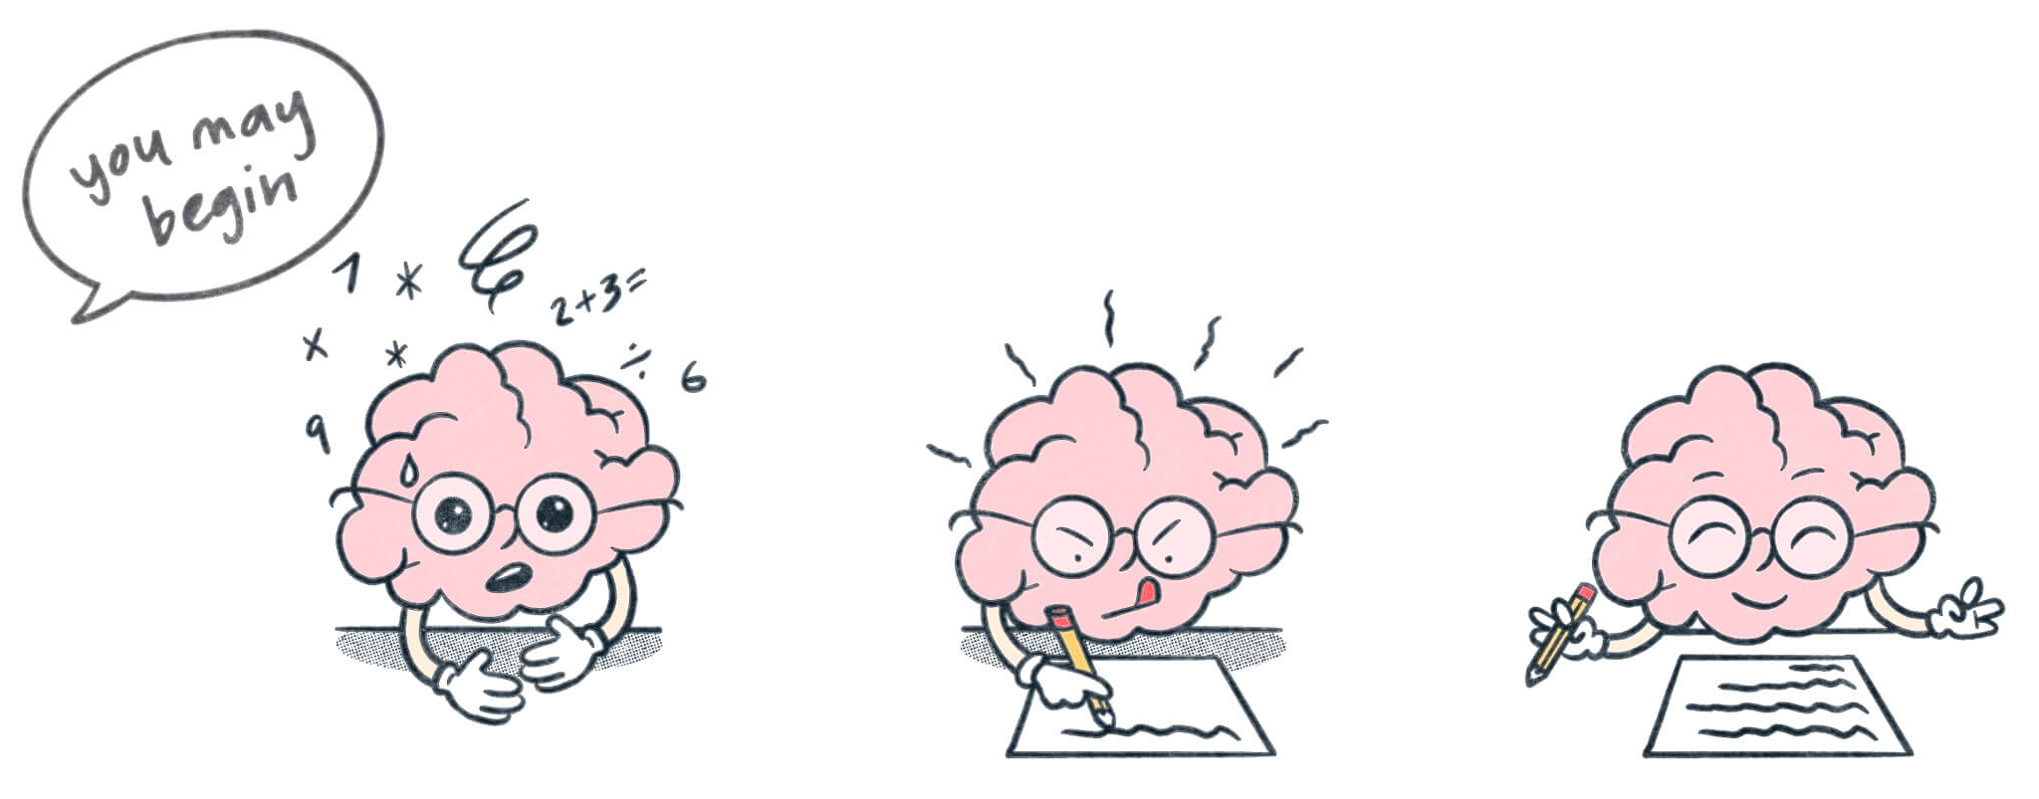
Contraception & STI’s BRAIN DUMP + KWL: (pg. 9)
This term our focus is on contraception and Sexually Transmitted Infections (STI’s).
Dump everything you think you know about CONTRACEPTION and STI’s into the brain dump space on your page.
Complete the first two columns of the KWL:
  What do you already KNOW about contraception and STI’s?
  What do you WANT to know about contraception and STI’s?
  We will revisit what you have LEARNED at the end of the term. Leave this column blank for now.
4 minutes to complete

Slide 11
POST IT SLAM – what is contraception?
Everyone will receive a sticky note.
Answer the question
Once you have answered, place your sticky note on the whiteboard.
You have 30 seconds.
WHAT
IS CONTRACEPTION?
Notes:
OPTIONAL
Read answers from the whiteboard. Comment on any common answers.
Resources = sticky notes.
Sticky

Slide 12
What is Contraception? (pg. 10)
Contraception means using an intervention when having sexual intercourse to avoid getting pregnant.
This is different from practising safe sex, which also includes protecting yourself and others from sexually transmitted infections (STIs).
Another common term for contraception is ‘birth control’.
There are a variety of contraceptive methods available depending on a person’s lifestyle and needs.
QUICK QUESTION:
Whose responsibility is it to think about contraception? Why?
BOTH!
Notes:
Relevant to test
Fill in their books.

Slide 13

SPIT FIRE ROUND: What are examples of contraception?
What contraceptive methods do you know?
Call them out!
Notes:
OPTIONAL

Slide 14
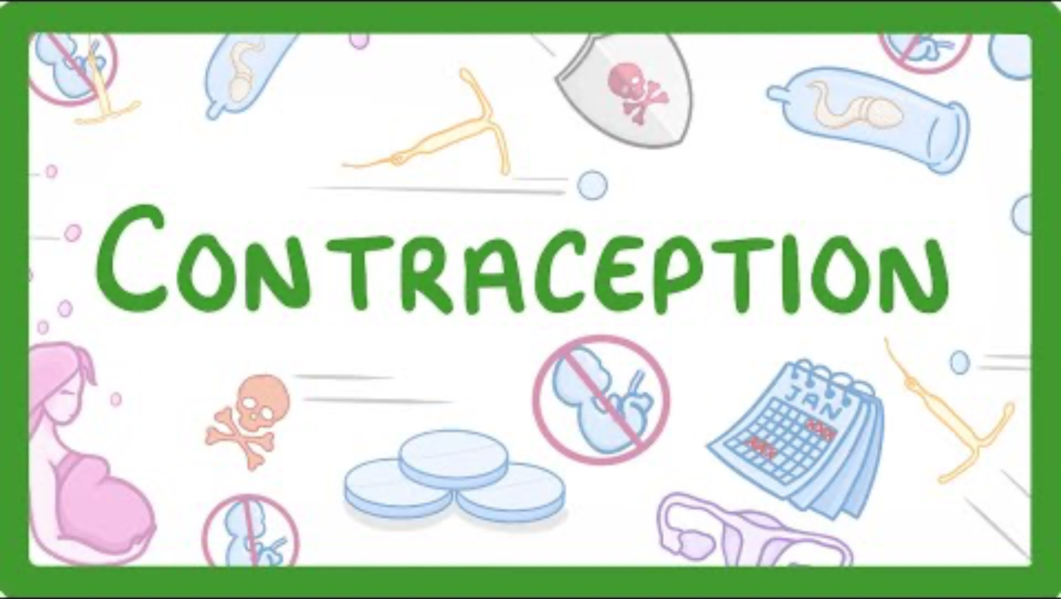
ACTIVITY 3: Contraception Types (pg. 10)
While watching the video, write a list of contraception methods that are mentioned into your books.
Notes:
OPTIONAL
Approx. 7 mins
Any extra time can be used to continue with the next PP and the contraception methods.
Video talks about different methods of contraception and how they work, including how hormonal methods impact hormones and prevent pregnancy.
https://youtu.be/kMY-v0F6bX0?si=E83uNy_WVzsVF1I9

Slide 15
Activity 4: (pg. 11)
Why do people choose to use/not use contraception?
There are a wide range of contraceptive methods available to use.
Consider reasons why someone would choose to use contraception vs. not use contraception.
Complete the T-chart in your books.
You have 5 minutes. Be prepared to share your responses.
Reasons TO USE contraception: | Reasons NOT TO USE contraception:
Notes:
OPTIONAL ACTIVITY

Slide 16

Activity 4: Answers
Add anything you don’t have to your books.
Reasons TO USE contraception: | Reasons NOT TO USE contraception:
Don’t want children
Some protect from STI’s
Can regulate periods
Clear up acne
Make periods lighter
Reduce migraines
Reduce PMS
Cost
Want children
Allergy
Religion
Convenience
Intoxicated
Lack of knowledge
Notes:
OPTIONAL ACTIVITY

Slide 17

GLOSSARY: (pg. 7)
Contraception:
  An intervention method used to prevent pregnancy from occurring.
At the front of your books is your glossary.
Turn to your glossary and add the following words and their definitions:

Slide 18
REFLECTION: How to say no… (pg. 11)
There may be a time in your life where you are in a situation where you may not feel comfortable and want to say no.
This could be any kind of situation, not just in a sexual scenario.
It is important that you can say no when you need to.
Q: What could you do or say when you want to say NO?
Being ASSERTIVE means…
State your answer/response → “No, I don’t want to have sex.”
Use ’I’ statements as this avoids placing the blame on someone else while still expressing how you feel → “I don’t feel comfortable”, “I don’t feel like this is the right time”, “I don’t want to.”
Be understanding.
A: BE ASSERTIVE
Notes:
Write the answer into their books.

Slide 19
CONTRACEPTION & STI’s
Year 10 Health Lesson 2 + Lesson 3 Term 2, 2024

Slide 20
Today’s Focus
List reasons why people choose to use/not use contraception.
Consider reasons to postpone sexual intercourse.
Define the different types of contraception.
Be introduced to the different methods of contraception.
Revision.

Slide 21

OPTIONAL HOOK: TRUE OR FALSE (pg. 12)
OPTION 1:
  Students complete the questions in their books (3 minutes).
  Go through answers as a class.
OPTION 2:
  Teacher to read out the statement.
  Students stand with TWO HANDS on their HEADS if they think the statement is TRUE.
  Students stand with TWO HANDS on their TAILS if they think the statement is FALSE.
Notes:
OPTIONAL
Choose which option you prefer.
Statements are found in the student/teacher workbook.

Slide 22
OPTIONAL Hook: (pg. 13)
Reasons to Postpone Sex
Reasons TO HAVE sex: | Reasons NOT TO HAVE sex:
There are a wide range of reasons why a person would choose to engage in sex, choose to not have sex or wait.
Consider these reasons by completing the T-chart in your workbooks.
Be prepared to share.
You have 5 minutes.
Curious
To fit in
Peer Pressure
In love
Want children
Don’t want kids
Don’t want an STI
Religious reasons
No one to have sex with
Don’t want to get in trouble
Illegal (underage)
Notes:
Relevant to test (but was covered in Lesson 6 & 9, T1 P.P.)

Slide 23
Types of Contraception (pg. 14)
There are 5 types of contraception for us to consider:
  Barrier – puts a barrier between the penis and the vagina and stops the sperm from meeting the egg.
  Hormonal – regulates or stops ovulation and so preventing pregnancy.
  Natural – doesn’t involve any kind of barrier or chemical etc. Natural methods of birth control.
  Emergency – used immediately after sex to prevent fertilisation.
  Surgical – sterilization; surgical procedure to control pregnancy/birth control.

Slide 24

Notes:
OPTIONAL – 4 mins
Funny video: Rachel comes over to tell Ross that she is pregnant with his baby, due to a contraception failure. Ross freaks out and tries to call the condom company and tell them off.
Discussion points:
Effectiveness: no method (other than abstinence) is 100% effective in preventing pregnancy.
Always check the use by date on condoms.
Condoms can split or fall off during intercourse. If this happens and ejaculation occurs, then the female will need to consider the use of the emergency contraceptive pill as a back up.
Emphasis on being careful as it can only take one time to get pregnant.
Discuss impacts of unplanned pregnancy: financial impacts (cost of appointments, raising a child etc.), physical health for the female, stress, work implications etc. (relevant to test)
https://www.youtube.com/watch?v=biZEstQVD24

Slide 25
Activity 2: Methods of Contraception (pg. 14-16)
The IDEAL contraception would be:
  Safe
  100% effective
  Free of side effects
  Easily obtainable
Follow along with the information in the upcoming slides to complete
your table in your books on the METHODS of contraception.
But unfortunately, this is not always possible to achieve. Just as every person is different, everyone may react differently to different forms of contraception, and have different reasons for use. There are a wide range of contraceptives available to try and accommodate for all.
Affordable
Acceptable to the user and sexual partner
Free of effects on future pregnancies
Notes:
The following slides will cover all the different methods of contraception. Using the information in the slides, students need to fill in the missing information in their tables in their books.
If time is an issue: use your best judgement and check against the test and pick the most relevant methods to focus on to allow you to get through enough content during lessons 2 & 3.
At the end of the contraceptive methods slides there are various optional activities which can be used as revision.
Be sure to hand out revision at the end of lesson 3 in preparation for the topic test during lesson 4.
**Vaginal Ring and Contraceptive Patch are in the PP, but not in the table in their books. Still speak about these methods using the slides.

Slide 26
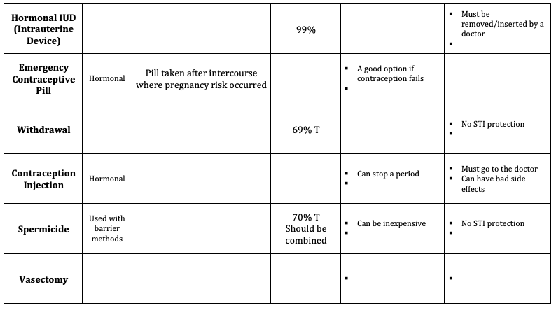
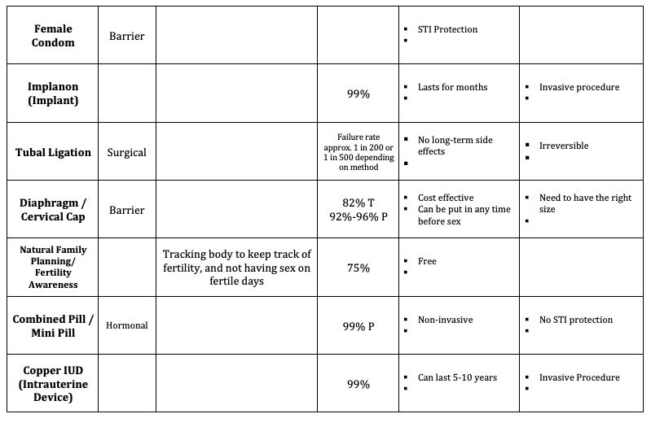
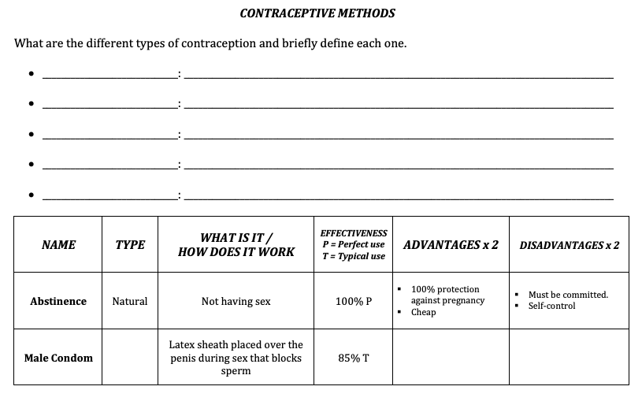
Activity 2: METHODS OF CONTRACEPTION (pg. 14-16)
As you move through to complete the tables and as each method of contraception is discussed, don’t forget to consider the advantages (pros) and disadvantages (cons) of each method.

Slide 27
IMPORTANT!
As we talk through this unit on sexual health, it is important to acknowledge that no two people are the same.
Just as we all have different hair colour, skin colour, facial features etc., penis and vagina also vary greatly in shape, size and colour.
As with contraceptive methods – everyone has their own preferences for various reasons (i.e., cost, ease of use, length of effectiveness, fit and comfort level etc.) and everyone will react differently or have different side-effects (particularly for hormonal methods). This is also why there are so many options available.
There is no one perfect penis, vulva or method of contraception.

Slide 28
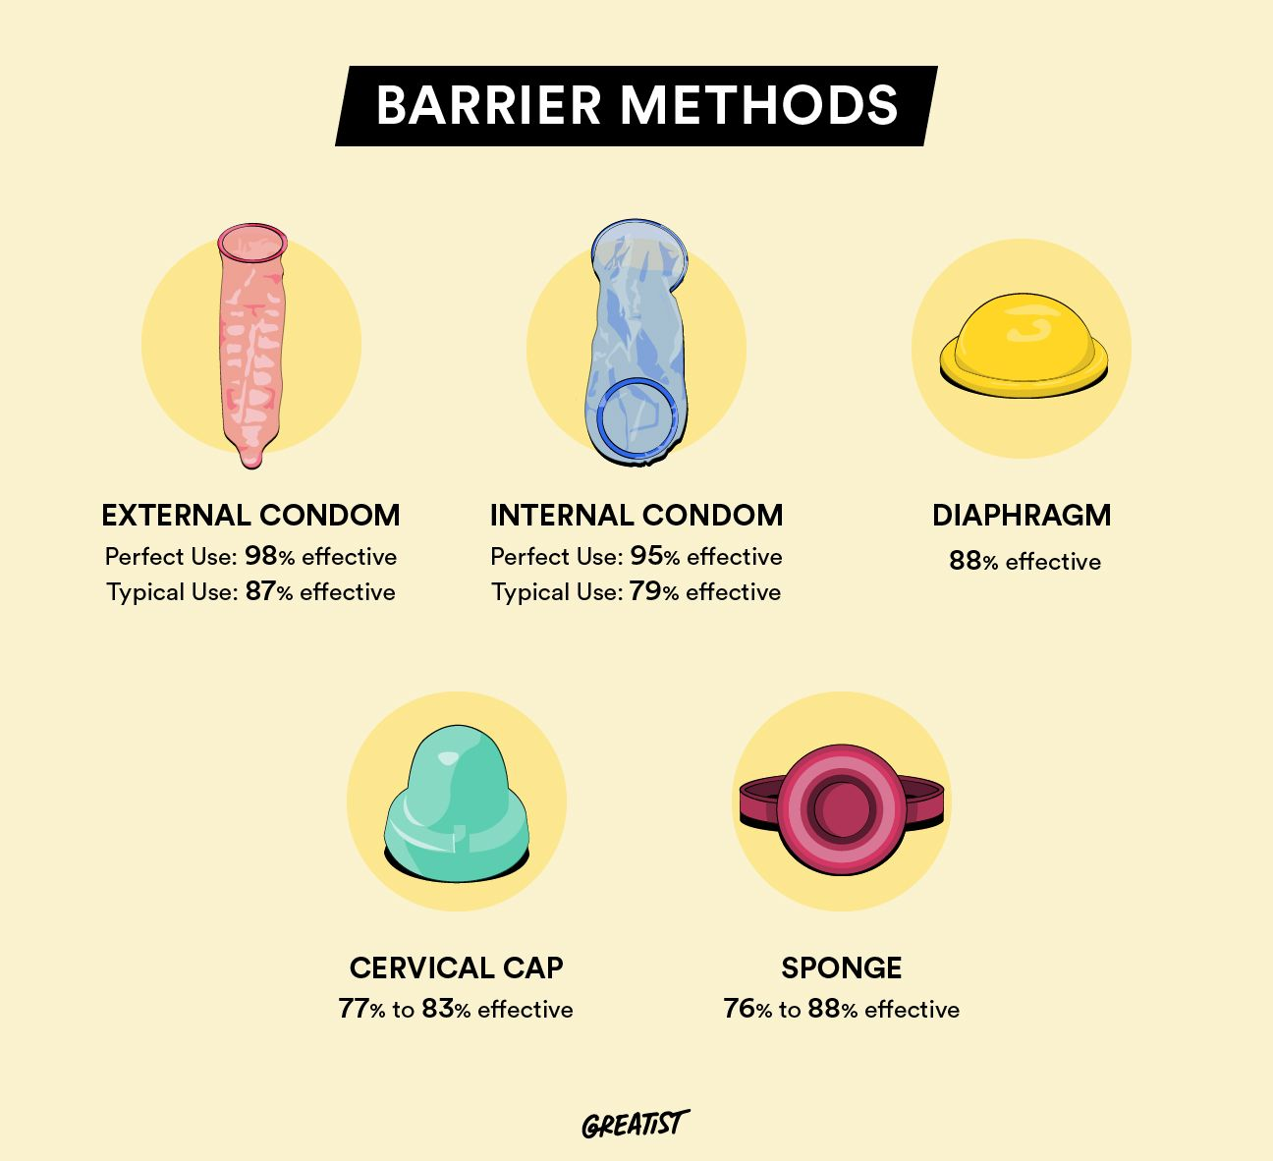
BARRIER METHODS:
Male condom (external)
Female condom (internal)
Diaphragm & Cervical cap
Spermicide

Slide 29
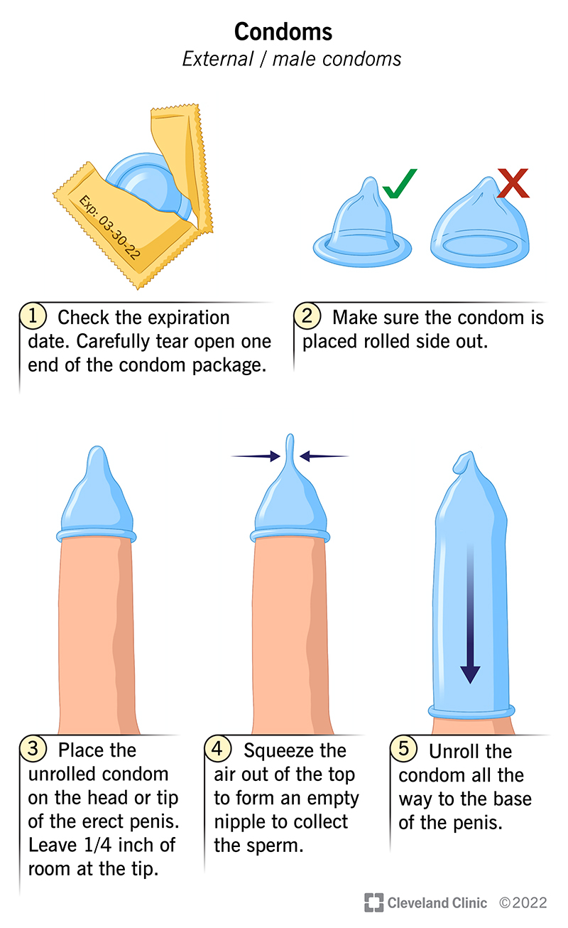
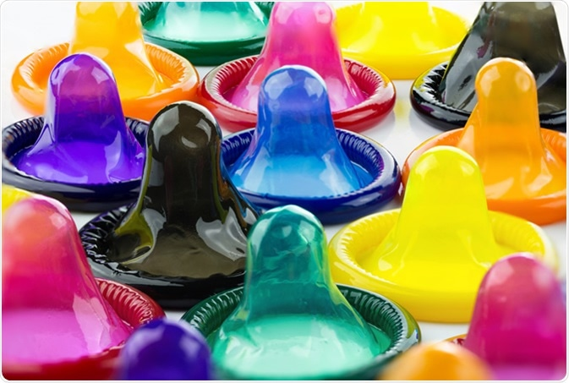
Male Condom
Only method of contraception boys can use.
It's really just a rubber, latex tube.
It's closed at one end like the finger of a glove so that when a boy puts it over his penis it stops the sperm going inside a girl's body.
It is a barrier method of contraception as it provides a barrier between the penis and the vagina and avoids any skin-to-skin contact.
Easily accessible.
94 – 98% effective if used correctly.
STI prevention.

Slide 30
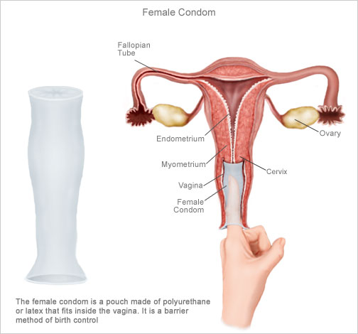
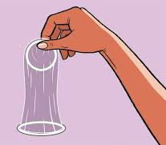
FEMALE CONDOM
Not as widely available as the male condom and is more expensive.
The closed end gets inserted into the vagina, and the penis enters
through the open end.
It also puts a barrier between the penis and the vagina and
therefore, prevents sperm from entering the female body.
95% effective if used correctly.
STI prevention.

Slide 31
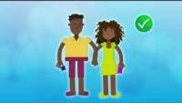
What you need to know about Condoms:
Notes:
OPTIONAL
2:52mins
https://www.youtube.com/watch?v=hNcDm37yj5Q

Slide 32
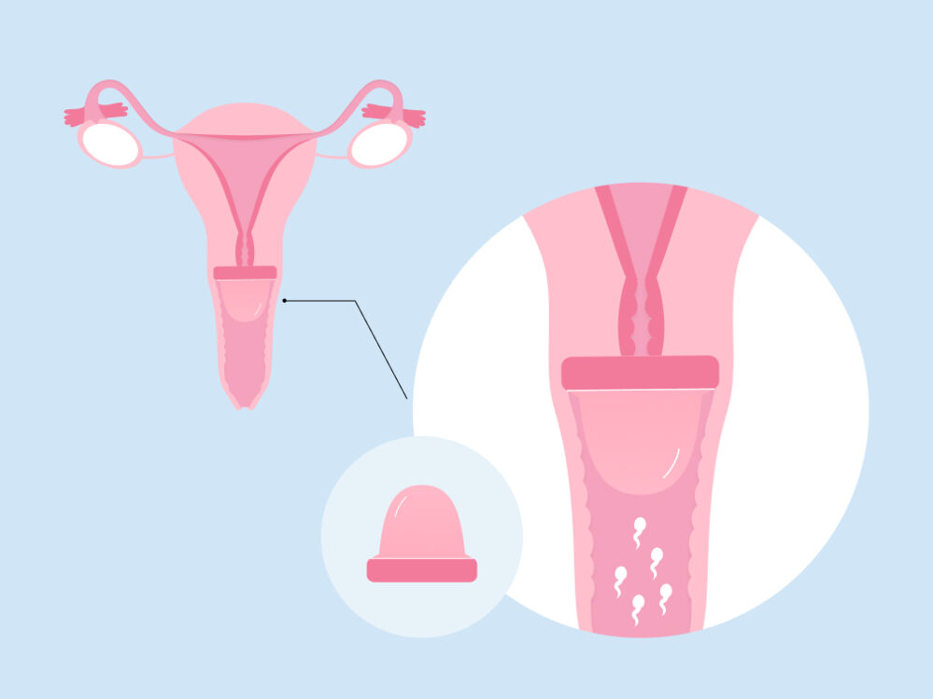
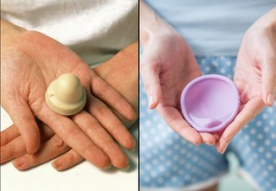
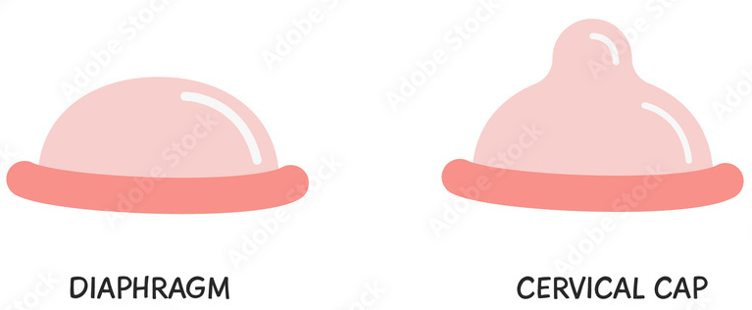
DIAPHRAGM & Cervical Cap
Puts a barrier covering the cervix so that sperm cannot enter the uterus.
A shallow dome of silicone with a firm, flexible rim.
Must be left in place for at least 6 hours after sex.
92% – 96% effective when used perfectly and with a spermicide.
Does not prevent STI’s.

Slide 33
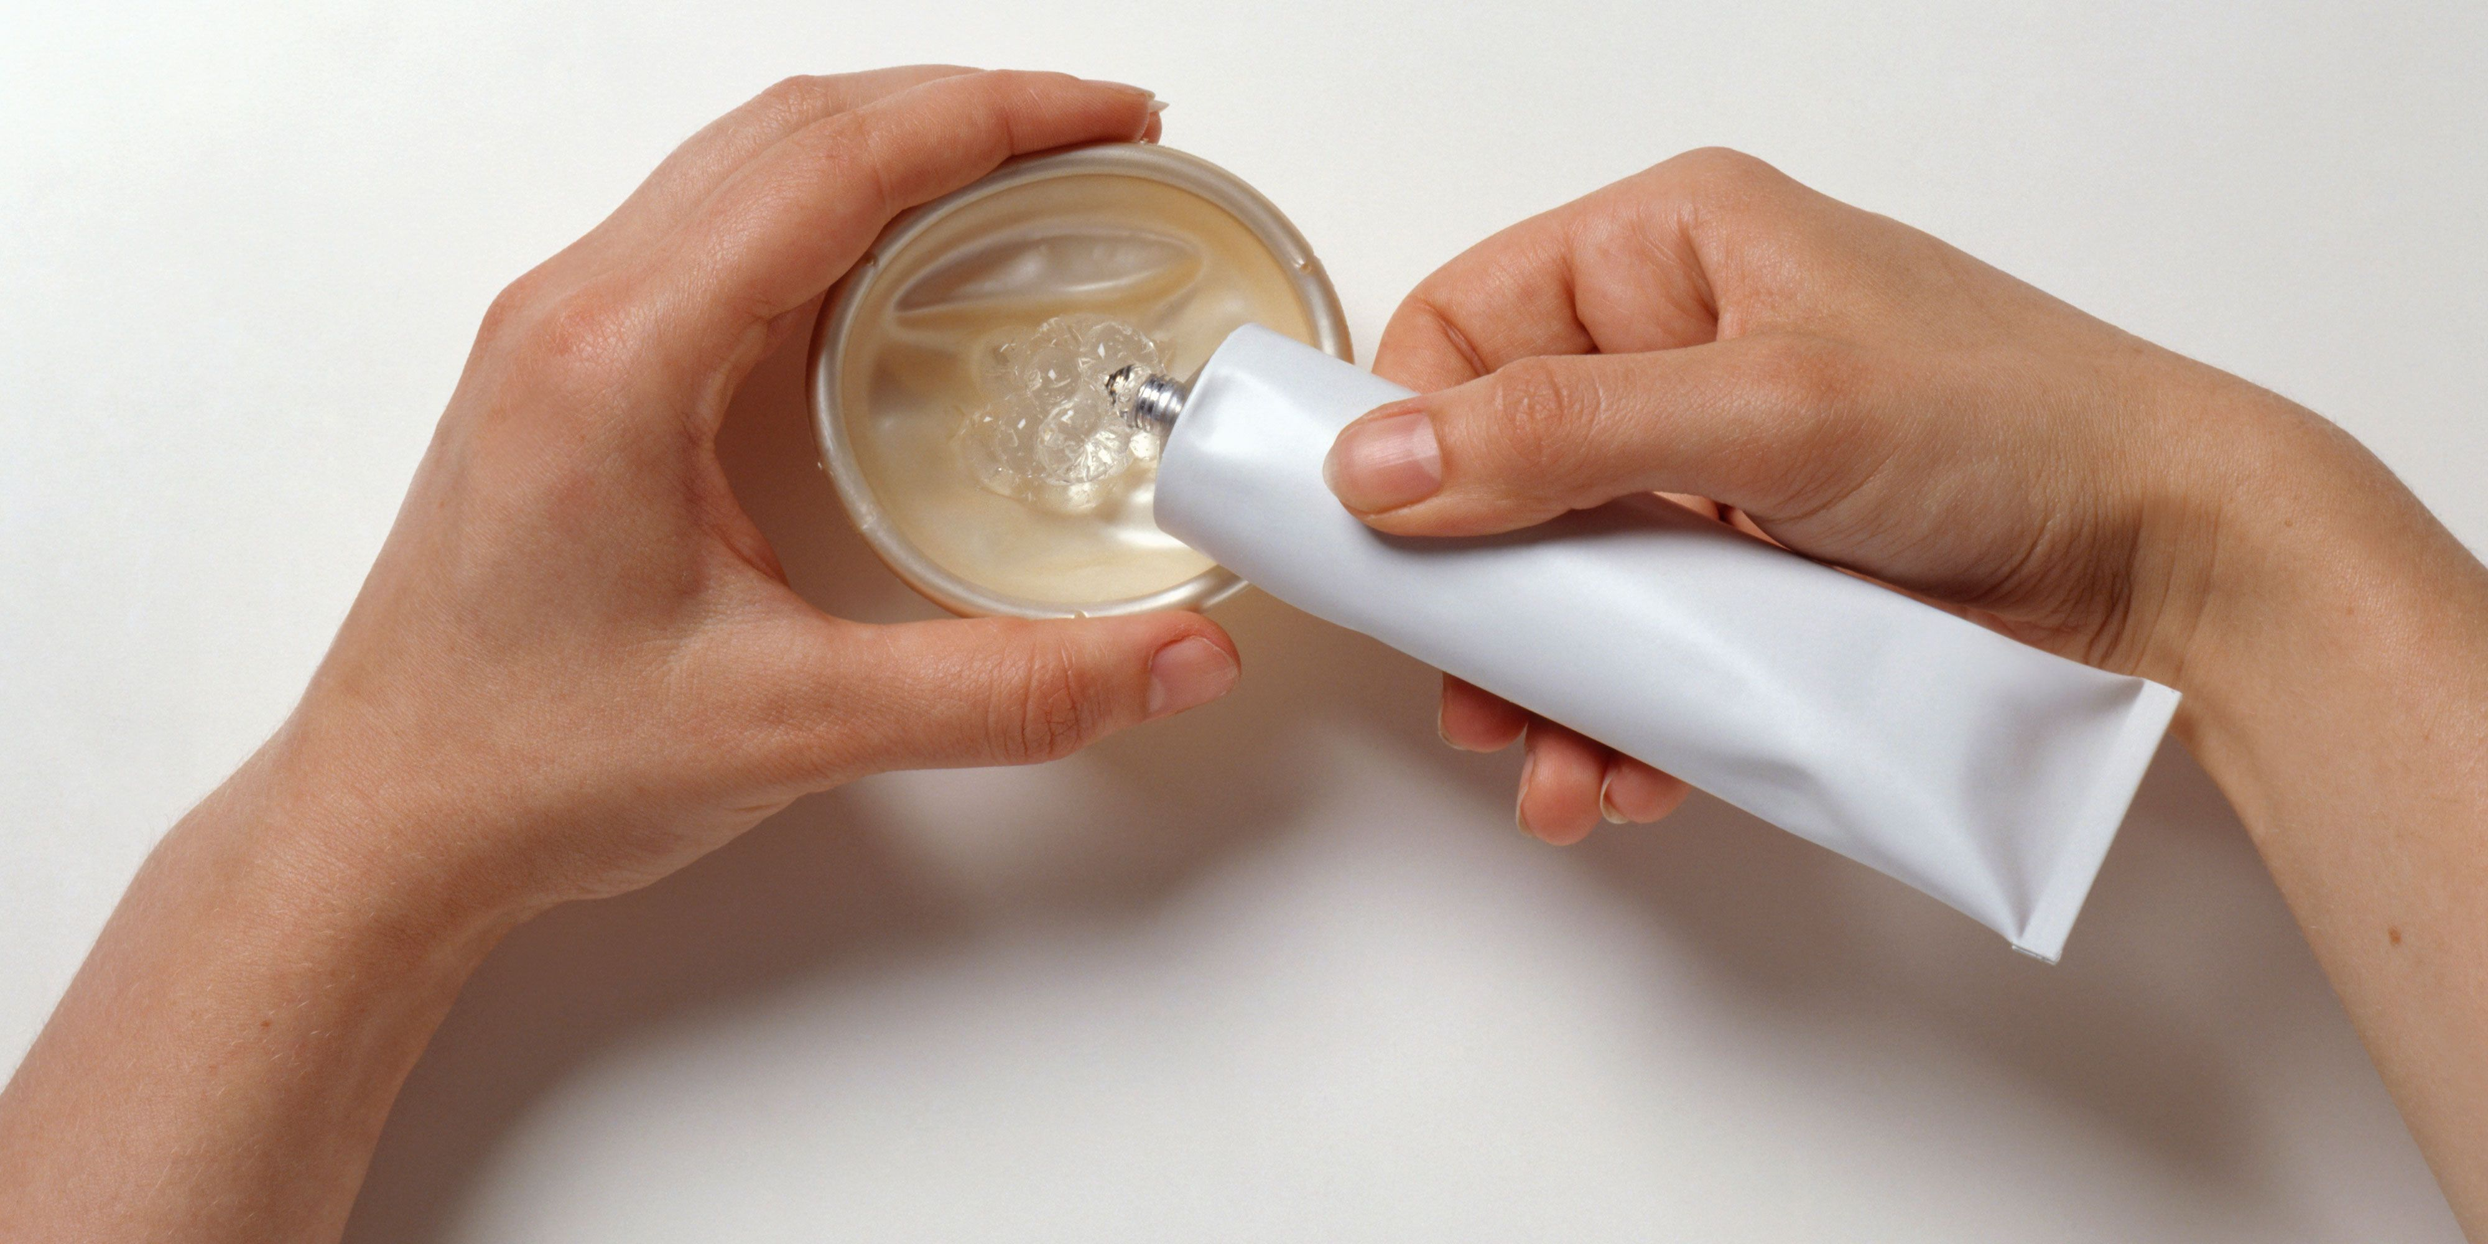
SPERMICIDE
Come in several different forms: cream, gel and foam.
Most spermicides contain nonoxynol-9, a chemical that blocks the sperm.
Up to 70% effective on their own. Can be inserted into the vagina.
Spermicides can be used alone but are more effective when used with another method of birth control, such as a condom or diaphragm.
Very little side effects.
Must follow instructions properly.
Does not prevent STI’s.

Slide 34
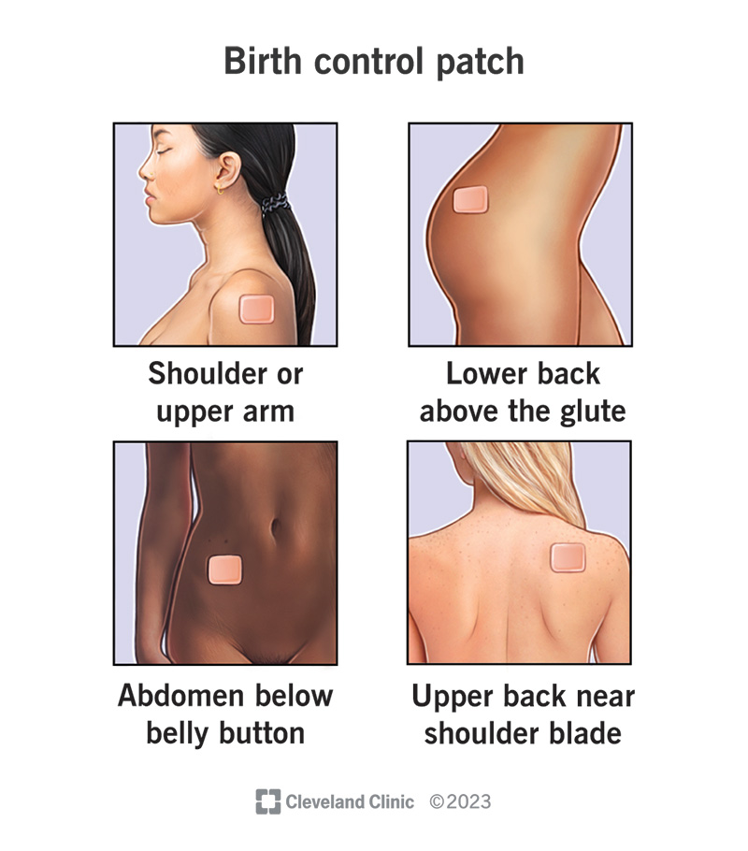
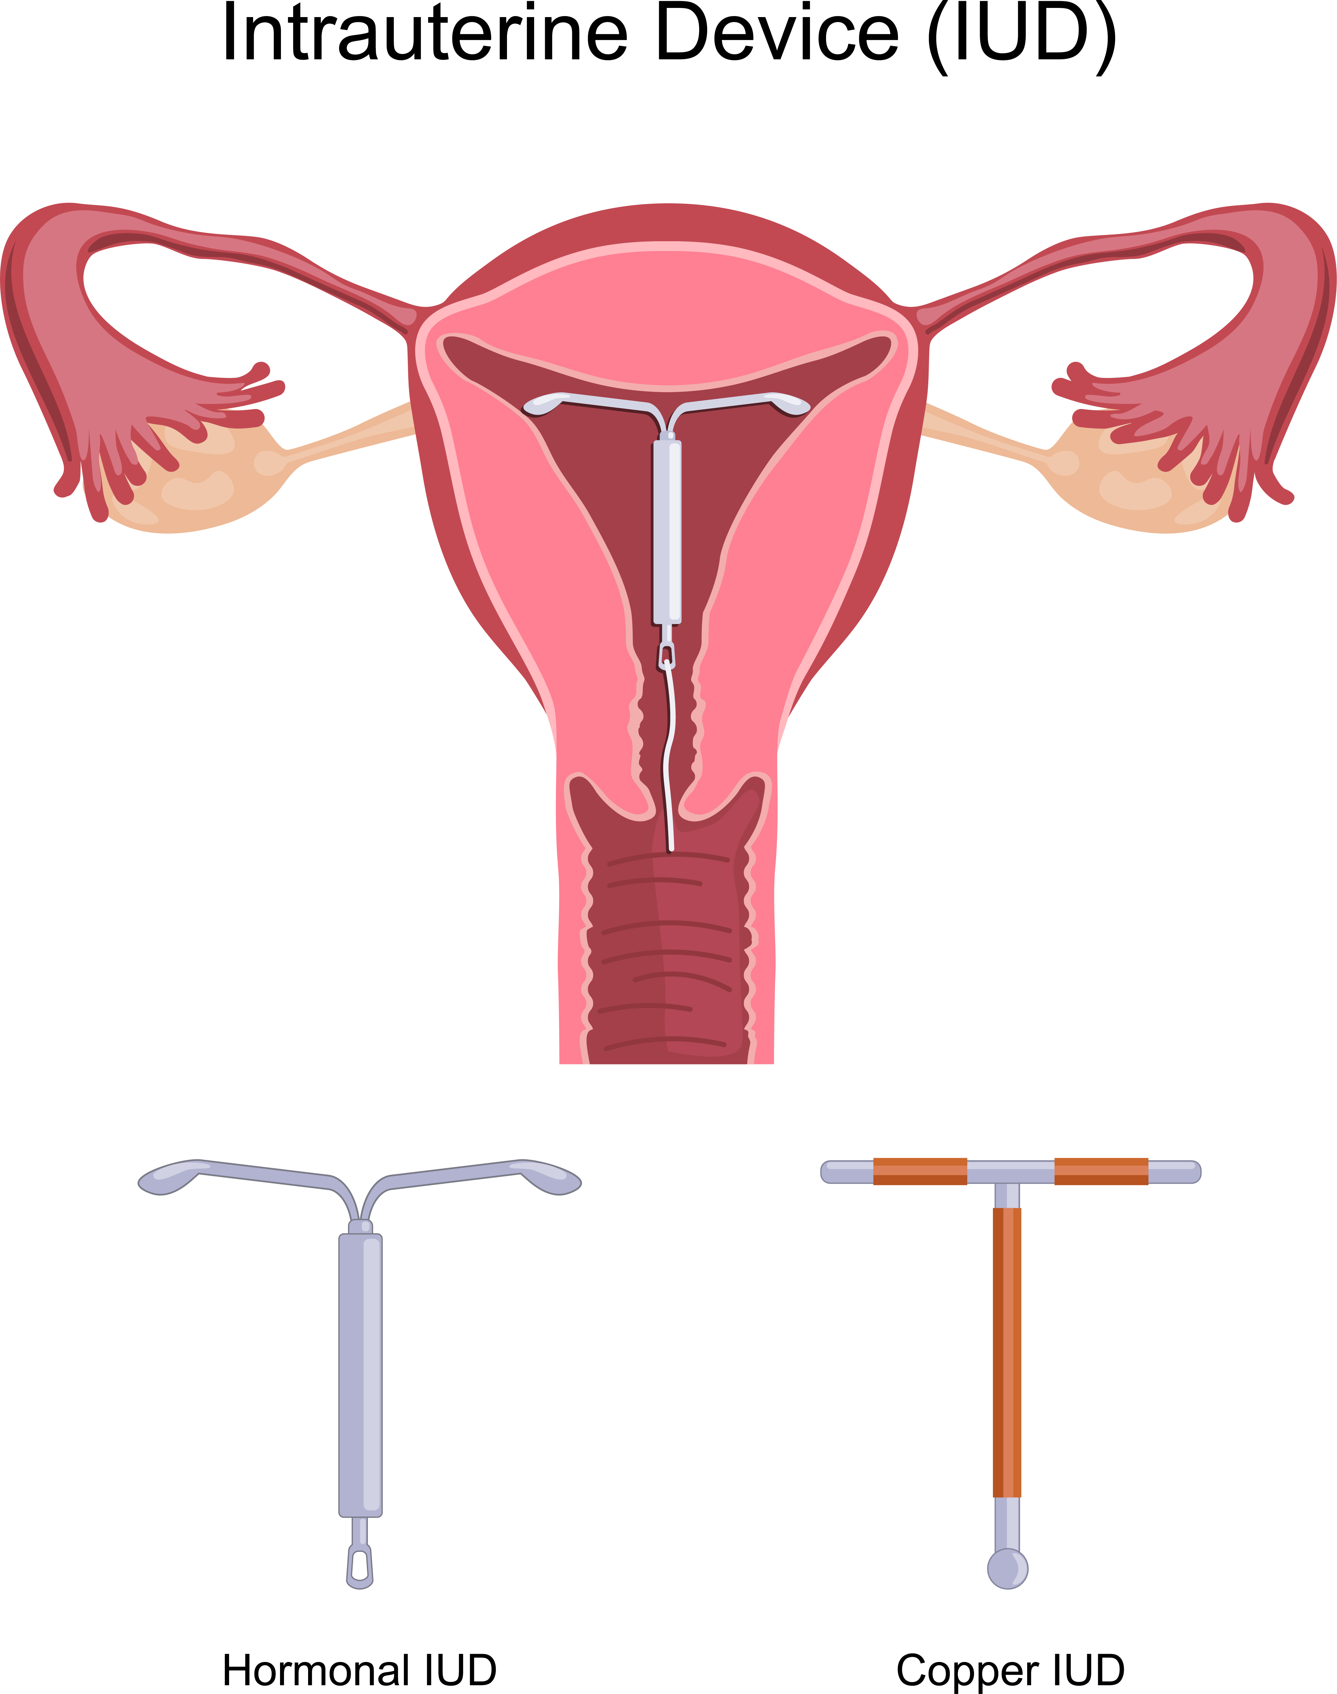
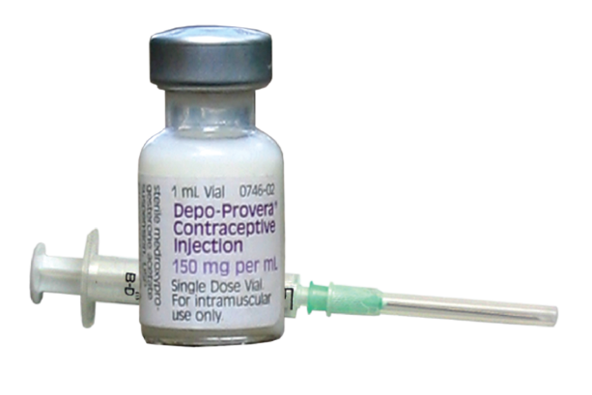
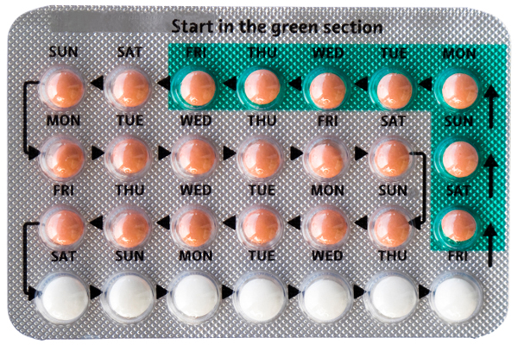
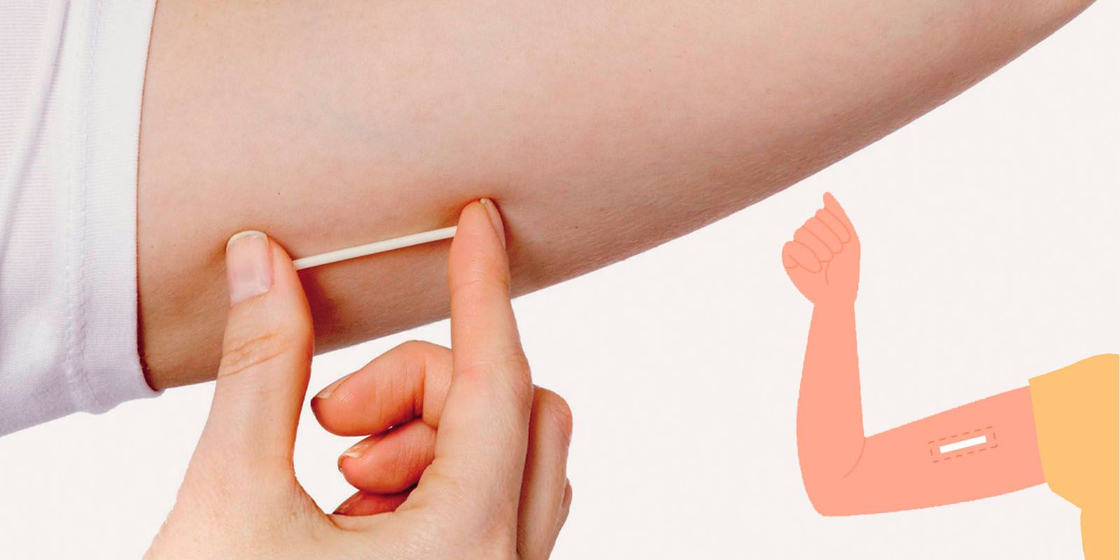
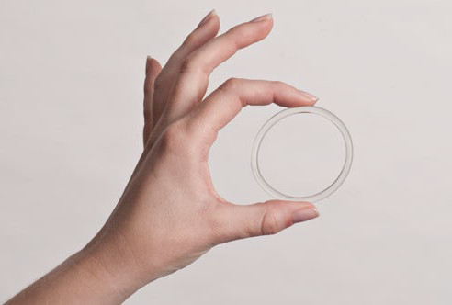
HORMONAL METHODS:
IUD – Copper (non-hormonal) or Plastic (hormonal)
Patch
Implanon/Rod
Injection
Vaginal Ring
Pill – Combined & Mini

Slide 35
Copper IUD
IUD = Intra-Uterine Device.
T shaped device with fine copper wire wrapped around the frame.
Placed inside the uterus.
Toxic to sperm which prevents fertilisation, slows the movement of sperm and changes the lining of the uterus to prevent implantation.
They can last for 5 – 10 years
(Long Acting Reversible – LAR method)
Side effects may include infection, uterine wall damage, heavier and longer periods, irregular bleeding.
It needs to be inserted and removed by a medical professional.
Can be used as an emergency contraception if inserted up to 5 days after unprotected sex.
99% effective.
Does not prevent STI’s

Slide 36
Hormonal/Plastic IUD
IUD = Intra-Uterine Device.
A small T shaped plastic device with a hormone (levonorgestrel) in the stem.
Placed in the uterus.
Stops fertilisation and makes the mucus thicker so the sperm can’t swim to the egg.
Changes the uterine lining so implantation cannot occur.
Lasts for 5 years (LAR method).
Side-effects may include bloating, headaches, mood changes, acne, lower sex drive, irregular bleeding or spotting.
It needs to be inserted and removed by a medical professional.
99% effective.
Does not prevent STI’s.

Slide 37
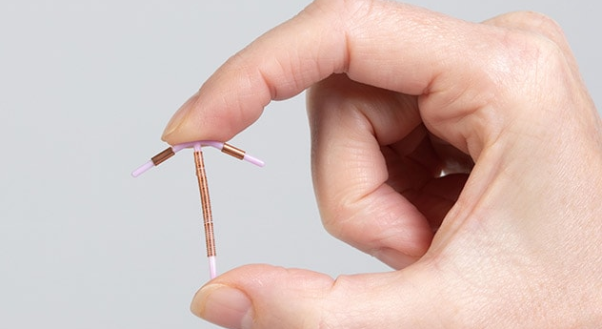
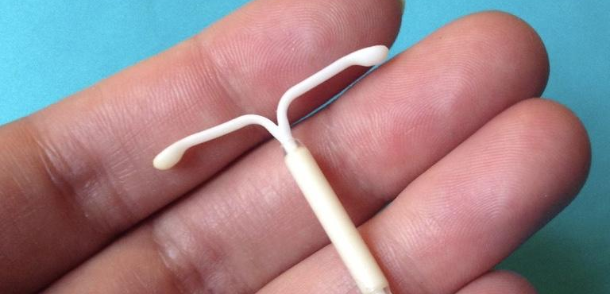

Slide 38
Patch
Contains hormones – oestrogen and progesterone (same as the combined pill).
Worn on the skin like a band-aid.
One patch is worn for a week at a time, for 3 weeks. The 4th week it is not worn, and menstrual bleeding will occur.
Releases hormones into the body that prevents ovulation from occurring.
Thickens cervical mucus, preventing sperm from reaching the egg.
Less serious side-effects may include spotting, irritation, menstrual pain, headaches, mood swings, weight gain, mood swings, blood clots etc.
Perfect use = 99% effective, typical use = 93% effective.
Does not prevent STI’s.
Notes:
NOT INCLUDED IN THE TABLE IN THEIR BOOK.

Slide 39
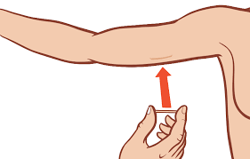
IMPLANON (ROD)
A small, thin, flexible 4cm rod that’s inserted under the skin on the inside of the upper arm.
Continuously releases small amounts of a progesterone hormone that prevents ovulation and thickens the cervical mucus.
Can be left in for up to 3 years.
Must be inserted and removed by a medical professional.
Side-effects may include a change in menstrual bleeding (irregular or
stopping), headaches, skin changes, tender breasts, mood swings.
99% effective.
Does not prevent STI’s.

Slide 40
INJECTION (DEPO-PROVERA)
Contains progesterone.
Injected into the buttock or upper arm muscle once every 3 months. It is only effective for that 3 months.
Prevents ovulation and thickens cervical mucus, preventing sperm from entering the uterus.
Needs to be administered by a medical professional and requires a prescription.
Side-effects may include weight gain, mood swings, , headaches, irregular, longer bleeding
or heavier bleeding, bone thinning, can take up to 18 months for fertility to return
after stopping use.
Perfect use = 99% effective, typical use = 95% effective.
Does not prevent STI’s.

Slide 41
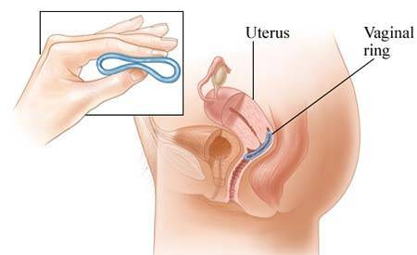
VAGINAL RING
Delivers low doses of oestrogen and progesterone.
Suppresses ovulation and thickens cervical mucus.
Inserted into the vagina.
It is inserted for 3 weeks and removed for 1 week, during which menstrual bleeding will occur. A new ring is then inserted.
Side-effects may include irregular bleeding, nausea, sore breasts, headaches, bloating, mood swings.
Perfect use = 99% effective, typical use = 93% effective.
Does not prevent STI’s.
Notes:
NOT INCLUDED IN THE TABLE IN THEIR BOOK.

Slide 42
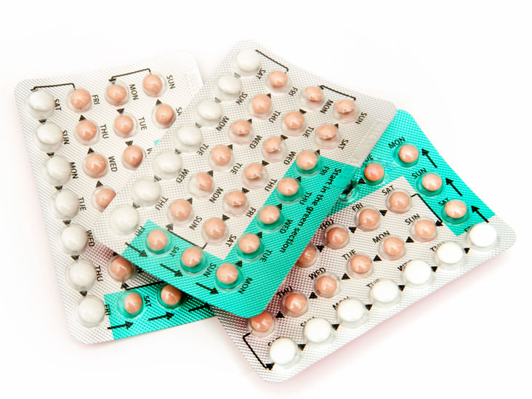
COMBINED PILL & Mini Pill
A pill taken daily that contains hormones.
Combined Pill = Oestrogen AND Progesterone, Mini Pill = Progesterone.
Works in 3 ways:
  Temporarily prevents ovulation.
  Temporarily thins the lining of the uterus, preventing implantation.
  Thickens cervical mucus to prevent sperm entering the uterus.
Must be taken every day. If it is forgotten, it can result in an unplanned pregnancy if sexual intercourse occurs.
A hormonal pill is taken daily for 3 weeks, and in the 4th week a sugar pill is taken, and this allows for menstrual bleeding to occur.
Effectiveness of the pill can be affected by severe vomiting, diarrhoea, or with antibiotics.
It can help make periods regular, can improve acne, can help manage other painful menstruation symptoms.
Side-effects may include weight gain, mood swings, nausea, bleeding, blood clotting, ovarian cysts, depression.
A prescription is needed for the pill.
There are many options of the pill available with different hormone dosages.
Perfect use = 99% effective, typical use = 91% effective.
Does not prevent STI’s
Notes:
Combined pill – contains two hormones (progesterone and oestrogen) and prevents ovulation.
Mini pill – contains progesterone only and works by changing the mucus of the cervix so that sperm cannot pass through.

Slide 43
GLOSSARY: (pg. 8)
Barrier Method:
  Puts a barrier between the penis and the vagina and stops the sperm from meeting the egg.
Hormonal Method:
  Regulates or stops ovulation and so preventing pregnancy.
At the front of your books is your glossary.
Turn to your glossary and add the following words and their definitions:

Slide 44
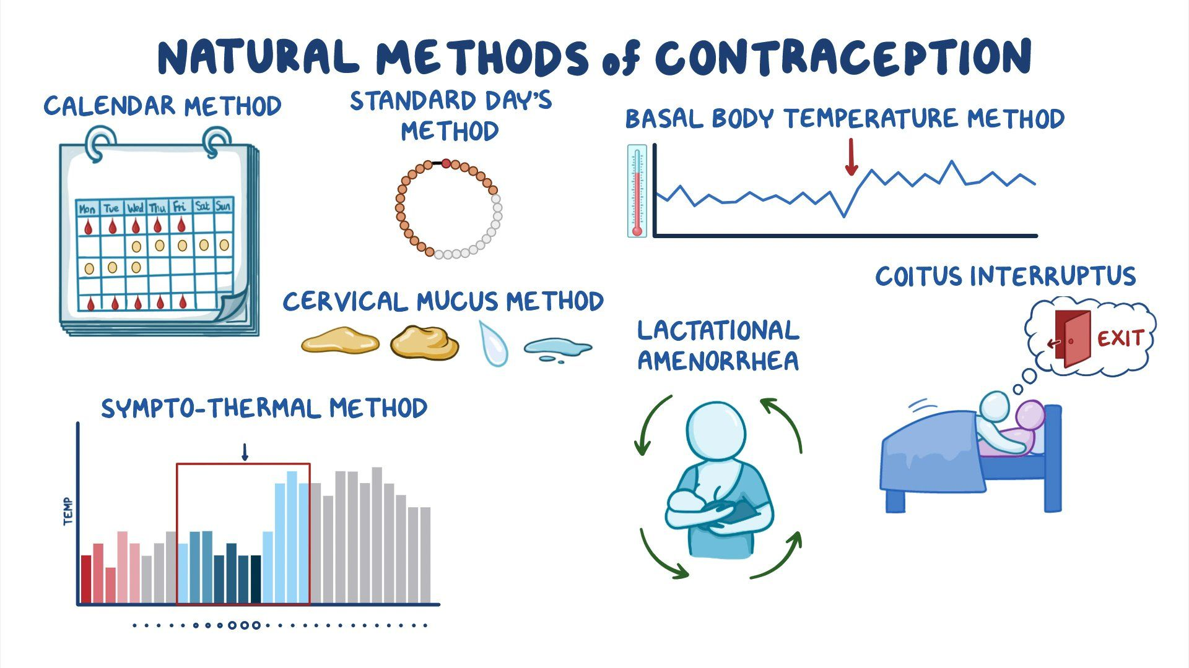
NATURAL METHODS:
Calendar (Rhythm Method)
  Basal Body Temperature
  Cervical Mucus
  Ovulation Awareness
Withdrawal
Abstinence

Slide 45
Natural Methods
Involve finding out when a woman is at her most fertile so she can be extra careful or avoid sex all together during these times.
A combination of techniques is recommended for increased effectiveness.
Methods include:
  Calendar (Rhythm) method
  Basal body temperature
  Cervical mucous method
  Ovulation awareness method
  Withdrawal

Slide 46
Rhythm Method
Used for females only with regular menstrual cycles.
This is done depending on the exact knowledge of ovulation and avoiding intercourse during the ovulation days.
For example: in a regular period that occurs every 28 days, ovulation should take place on day 14, so intercourse should be avoided 4-5 days before and after ovulation.
Ovulation can be detected by:
  Basal body temperature – Increased body temperature by approx. 0.5 C
  Cervical mucus – Change in type of cervical mucous
  Ovulation awareness - Using an ovulation kit which can measure the amount of LH hormone present on that day.
There are apps available that allow women to track their menstrual cycle, body temperature, predicted ovulation etc.
Perfect use = 95% effective, typical use = ~75% effective.
Does not prevent STI’s.
Notes:
Apps include Apple Health App, Cycles, Flo - some have free services, others have subscriptions available.

Slide 47
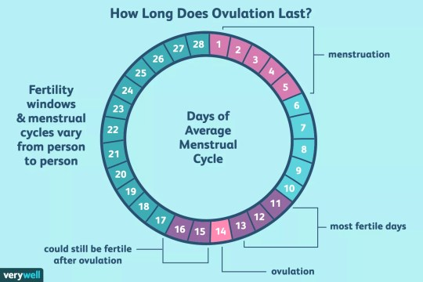
Fertility windows are different for every person, and it does rely on a regular menstrual cycle, so it is still important to exercise caution if a person does not want to get pregnant.
While uncommon and the chances are lower, a person can still fall pregnant while on their period.

Slide 48
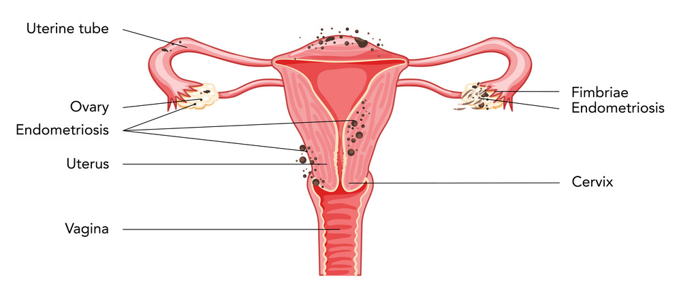
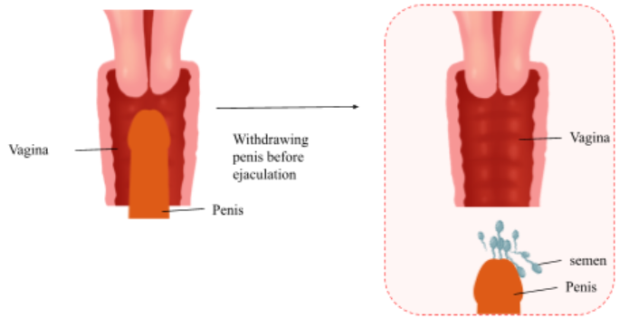
Withdrawal
A.K.A. Coitus Interruptus or ‘pulling out.’
The withdrawal/removal of the penis from the vagina before ejaculation occurs.
Relies on timing and self-control.
Still a chance of pregnancy as pre-ejaculate (the fluid before ejaculation) can contain sperm.
Perfect use = 96%, typical use = 78%
Does not prevent STI’s.

Slide 49
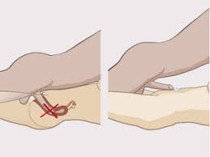
Pre-ejaculate can still contain semen, meaning there is still a chance pregnancy could occur.
If using the withdrawal method, it is important for the ejaculate to be away from the vulva/vaginal opening.
Withdrawal method can be partnered with a hormonal method.
Notes:
OPTIONAL to show this image with your class. Gauge your classes maturity level.
Can use this slide to discuss the importance of withdrawal not occurring near the vulva/vagina. Pre-ejaculate can still contain semen which means it can still lead to pregnancy so if the withdrawal method is being used, it is important to withdraw/pull out away from the vaginal opening.
Withdrawal method can be partnered with other hormonal contraception.

Slide 50

ABSTINENCE
Not engaging in any kind of sexual contact or behaviour.
100% effective (the only method).
STI prevention.

Slide 51
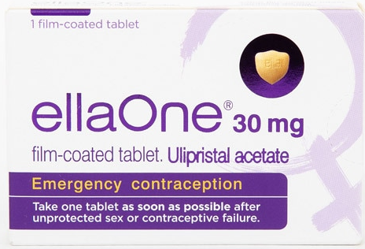
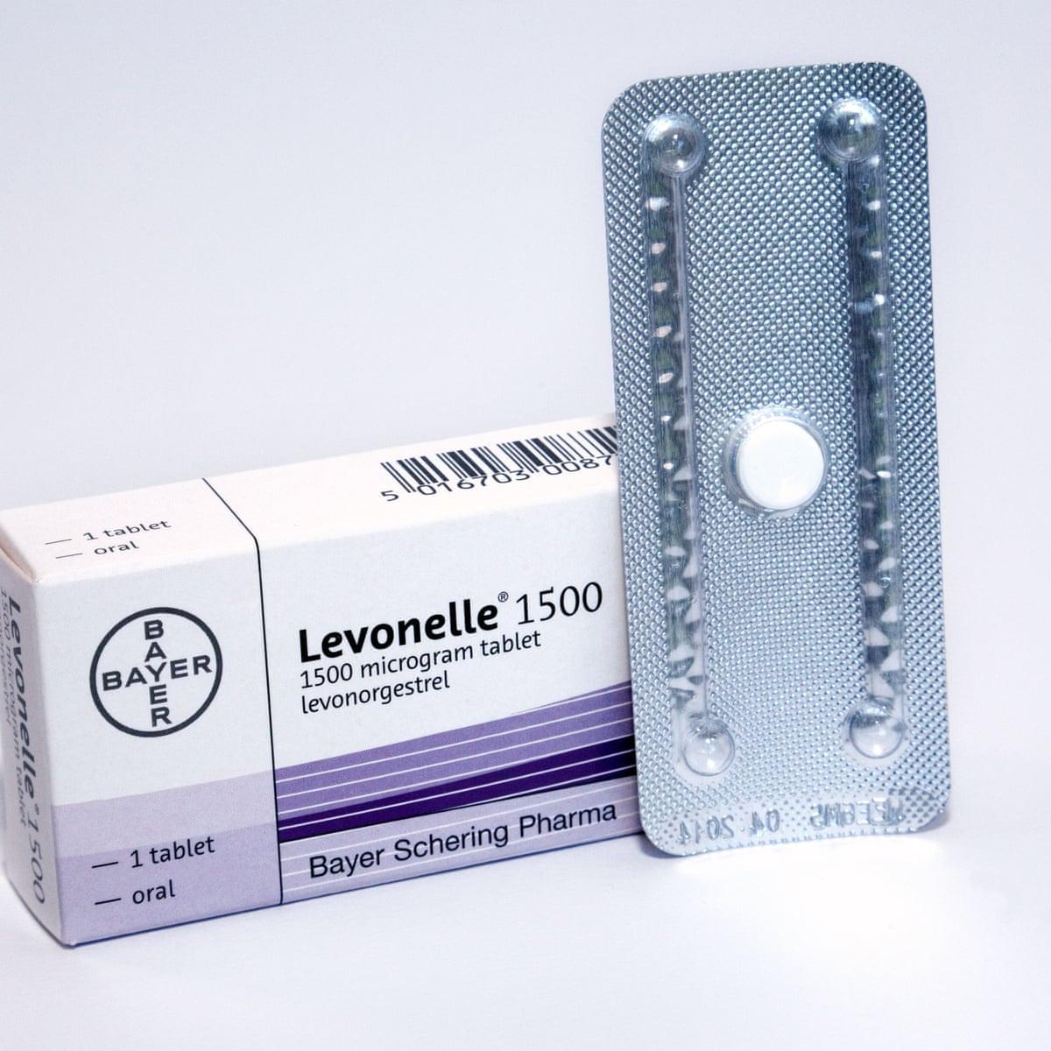
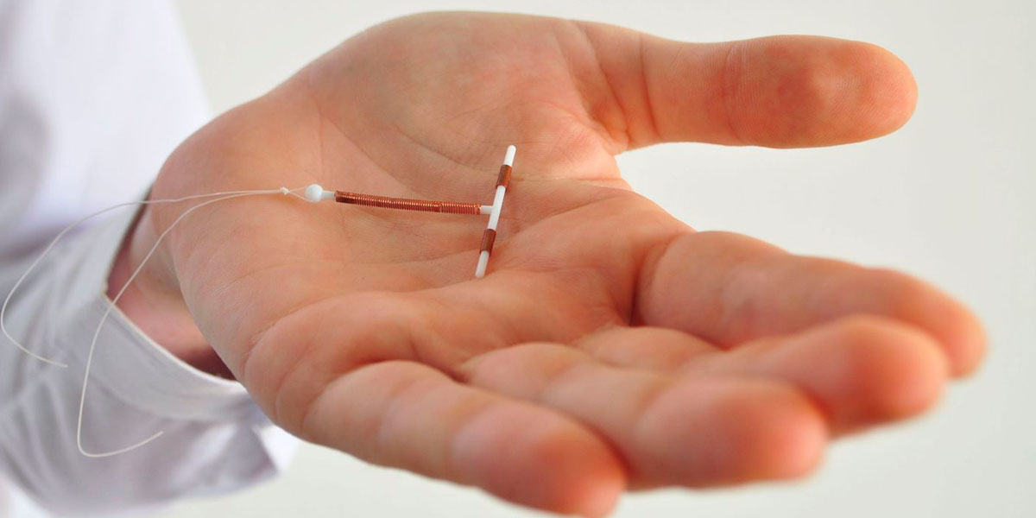
EMERGENCY METHODS:
Emergency Contraceptive Pill/Plan B
Copper IUD
Notes:
Mention the copper IUD as an emergency method – can be inserted up to 5 days after having unprotected sex.

Slide 52
EMERGENCY CONTRACEPTIVE PILL / PLAN B
A.K.A. Morning After Pill.
A ‘one-off’ pill taken ASAP after unprotected sex or where a contraceptive failure has occurred.
  The sooner it is taken, the more effective it is in preventing pregnancy.
Available without a prescription.
Not to be used as a regular form of contraception.
Works by preventing or delaying ovulation.
Side-effects may include a heavier next period or have an early or later period, nausea, headaches, bloating, tender breasts.
85% effective (varies depending on when the pill is taken).
Does not prevent STI’s.
Notes:
Contraceptive failure = missed pill, condom malfunction (incorrectly used, slipped off, split)

Slide 53
Copper IUD - RECAP
T shaped device with copper wire.
Placed inside the uterus.
Toxic to sperm which prevents fertilisation, slows the movement of sperm and changes the lining of the uterus to prevent implantation.
They can last for 5 – 10 years
(Long Acting Reversible – LAR method)
Can be used as an emergency contraception if inserted up to 5 days after unprotected sex.
99% effective.
Does not prevent STI’s

Slide 54
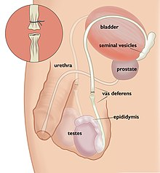
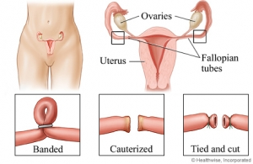
SURGICAL METHODS:
Tubal Ligation (female sterilisation)
Vasectomy (male sterilisation)

Slide 55
Tubal Ligation
A.K.A. Female sterilisation or getting ‘tubes tied’.
A surgical procedure where the fallopian tubes (the tubes that carry the eggs from the ovary to the uterus) are cut or tied.
Prevents the egg entering the uterus and therefore a sperm meeting an egg.
Permanent**
Menstrual bleeding will still occur monthly.
99+% effective.
Does not prevent STI’s.
Notes:
99+% effective – if in some way the tubes become unblocked, then there is still a chance of pregnancy.
** Usually permanent – depending on how the procedure occurs, and the age of the female, there could be room for reversal. If reversed, there is a higher chance of ectopic pregnancy.
Pregnancy can still happen via IVF if a person changed their mind about having children.

Slide 56
Vasectomy
A.K.A. Male sterilisation or ‘the snip.’
A surgical procedure where the vas deferens (the tube that carries sperm from the testes to the penis) is cut.
Effective 3 months after the procedure.
Permanent**
99+% effective.
Does not prevent STI’s.
Notes:
**Reversal procedure does not always work, and fertility may not be regained.
IVF is still possible as the testes continue to produce sperm. If sperm was not stored before the procedure, it may be possible for sperm to be retrieved with a minor procedure.

Slide 57
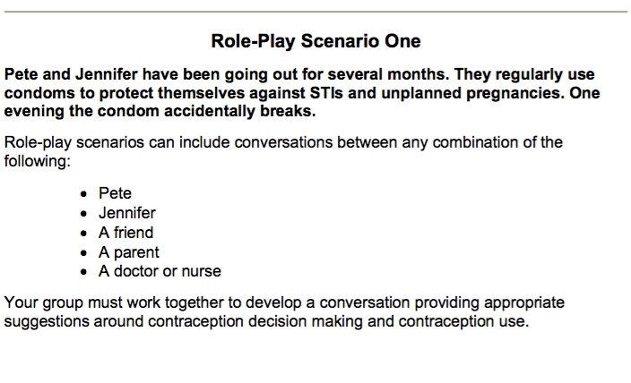
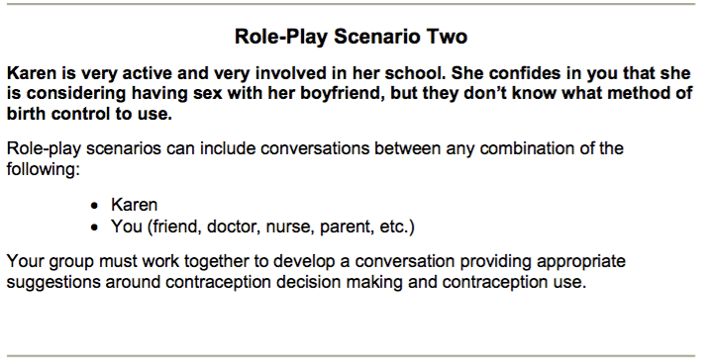
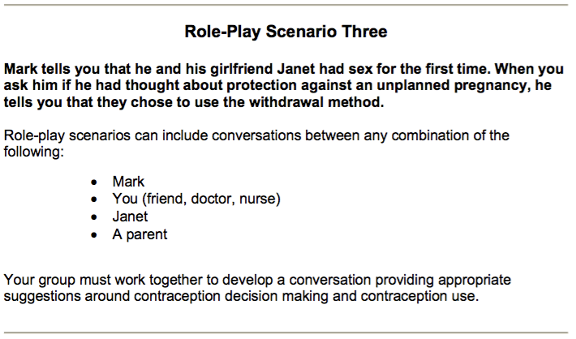
Activity 3: contraception scenario’s
Which is best and why? (pg. 17)
Students will work in small groups or pairs.
Each group will be given a scenario card.
Read the scenario and decide on the best method/s of contraception to use in that situation for the people involved.
Notes:
RELEVANT TO TEST.
Resources available in health storeroom.
Ways to complete this activity:
As role plays:
Students work in small groups and perform the scenario card as a role play acting out the scene and contraception discussion.
Complete the scenarios in their books:
In their workbooks, three scenarios have been included. Students can spend time responding to the questions on their own. Discuss answers as a class.
Can also be completed as a reflection/revision activity.
THREE different scenarios are included in their workbooks to encourage them to consider different methods of contraception based on the scenario given.
Group → whole class discussions:
Students work in small groups and each group will be given a different scenario to discuss. Taking turns, each group will read out their scenario and their response to the rest of the class. Allow for whole class discussion.

Slide 58
Optional Activity 4: Contraception Kit
Use the contraception kit to show students the different methods of contraception.
Notes:
Resource available in Health Storeroom.

Slide 59
Optional Activity 5:
Contraception Matching activity
Students are to work in small groups. Each group will receive a set of cards. Together, they need to match the contraception method to its correct pros and cons.
Notes:
Resource available in Health Storeroom.
Can be used as a revision activity.

Slide 60

REMINDER:
TOPIC TEST NEXT WEEK
Complete your revision worksheet.
Notes:
Hand out revision
Any time remaining at the end of the lesson can be spent doing revision.
OR complete the previous activities and hand out revision as homework.

Slide 61
REMINDER!
As we talk through this unit on sexual health, it is important to acknowledge that no two people are the same.
Just as we all have different hair colour, skin colour, facial features etc., penis and vagina also vary greatly in shape, size and colour.
As with contraceptive methods – everyone has their own preferences for various reasons (i.e., cost, ease of use, length of effectiveness etc.) and everyone will react differently or have different side-effects (particularly for hormonal methods). This is also why there are so many options available.
There is no one perfect penis, vulva or method of contraception.

Slide 62
CONTRACEPTION & STI’s
Year 10 Health Lesson 4 Term 2, 2024

Slide 63
Today’s Focus
Topic Test.

Slide 64

Test CONDITIONS:
You have ONE period to complete the test
Separate all desks.
You need a pen.
No talking or cheating.
  May result in a loss of marks/score of 0.
Raise your hand if you finish early or have a question.

Slide 65
CONTRACEPTION & STI’s
Year 10 Health Lesson 5 Term 2, 2024

Slide 66
Term Timeline:
Week 5 STI’s.
Week 6 = STI’s + Task 3: STI Oral Presentations.
Week 7 = Work on assignment.
Week 8 = EXAM BREAK.
Week 9 – 11 = Assignment Presentations.
- ALL assignments are due in week 9 and names will be drawn at random.
Notes:
Year 10 Social Event on Thursday week 11 (27th June)

Slide 67
Today’s Focus
Define STI and the different types.
Practice STI prevention.

Slide 68

OPTIONAL:
https://create.kahoot.it/share/duplicate-of-sti-s/c27f6ea9-2b50-418b-812a-25b134679b46
Notes:
OPTIONAL ACTIVITY
https://create.kahoot.it/share/duplicate-of-sti-s/c27f6ea9-2b50-418b-812a-25b134679b46

Slide 69

Activity 1: Handshake Activity
Notes:
RESOURCES – print O + X’s worksheet (available on shared drive/connect). Make sure there are enough, so each student gets one shape (either O or X).
Everyone in the class receives a piece of paper with either a O or a X on it (can give these out as students walk through the door).
**Give the X to students who won’t mind being told they spread an STI or will go around and be lively in shaking hands.**
All students need a pen.
Students need to walk around and shake hands with each other.
If you have an O, you write an O on the other person's paper when you shake hands.
If you have an X, you write an X on the other person’s paper when you shake hands.
If you are an O and shake hands with an X, and now have an X on your paper, you are now an X and will continue to write X on other people’s paper when you shake hands.
Allow 1-2 minutes to walk around and shake hands.
Debrief:
Stand up the people who have the X shape on their paper. Stay standing.
Stand up if you shook hands with one of these people. Stay standing.
Now stand up if you shook hands with one of these people.
Everyone with an X on their paper now has an STI.
This activity is used to demonstrate that STI’s can be invisible and can be easily transmitted through skin-to-skin contact.

Slide 70
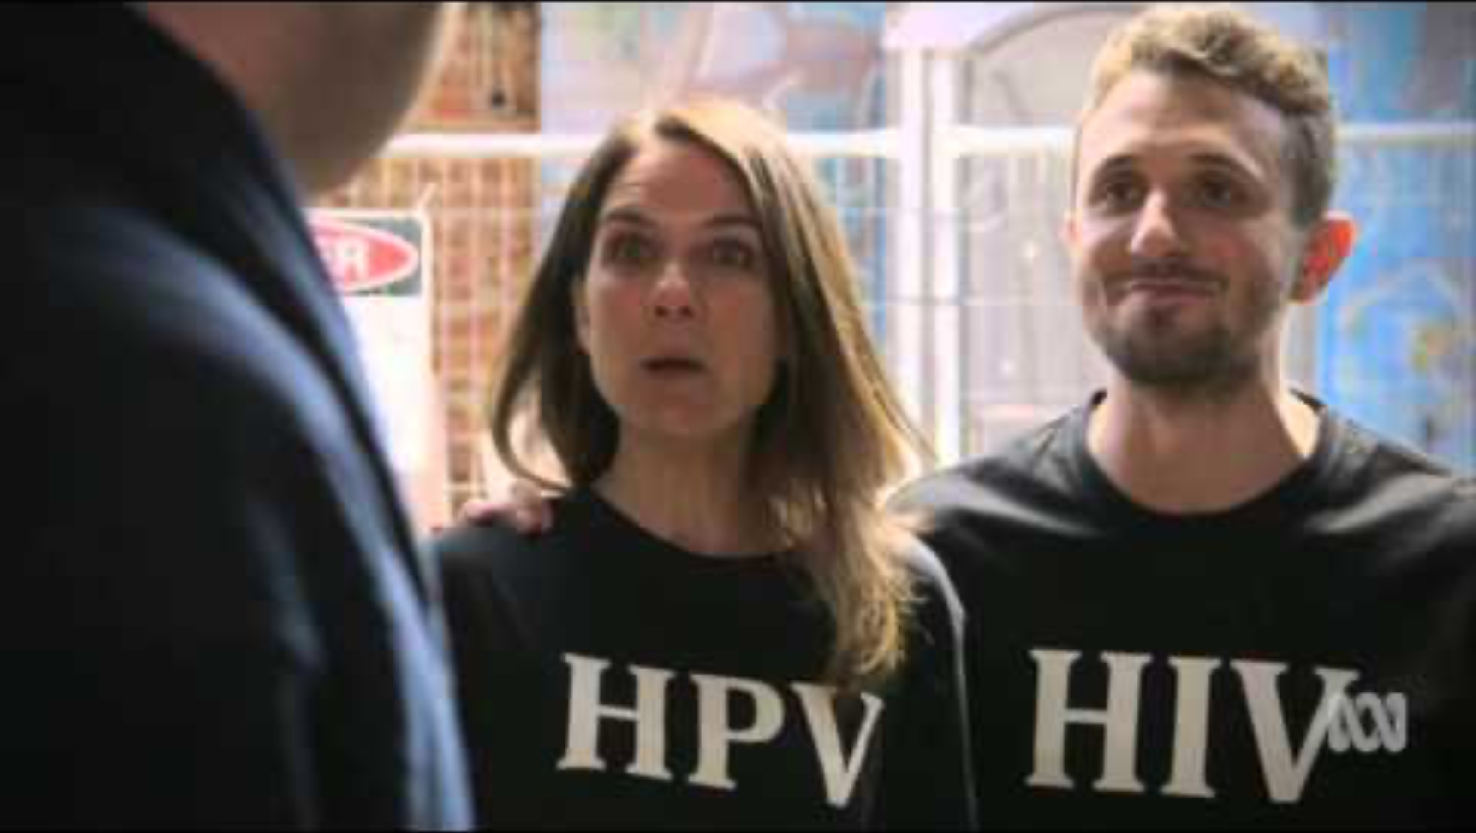
Notes:
OPTIONAL
STI House – 2:26mins

Slide 71
SPIT FIRE:
Types of STI’s
Notes:
After watching the video, ask students to recall the STI’s that were mentioned.

Slide 72
GLOSSARY: (pg. 7)
Sexually Transmitted Infection:
  An infection most commonly spread through unprotected sexual contact.
At the front of your books is your glossary.
Turn to your glossary and add the following words and their definitions:

Slide 73
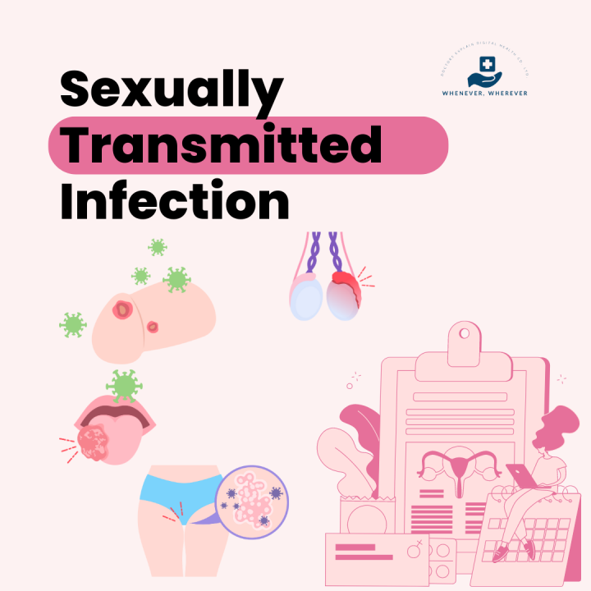
What are sexually transmitted infections? (pg. 18)
STI’s are bacterial or viral infections that are most commonly passed through unprotected sexual contact with an infected partner:
Oral sex
Vaginal sex
Anal sex
Skin-to-skin contact
For transmission to occur, it is necessary to have
A body fluid with the germ in it
A way of spreading the germ from one person to the other
STI’s can also be transmitted during pregnancy, childbirth and breastfeeding and through infected blook or blood products.
Notes:
Inform students that STI’s and STD’s mean the same thing (Infections vs. Diseases) but that STI’s is the language more commonly used now.
The concepts of disease suggests a clear medical problem, usually some obvious signs/symptoms. But commonly, many sexually transmitted diseases do not have obvious signs/symptoms or have mild signs that can be easily overlooked. So, the term ‘infection’ is more commonly used now, though may or may not result in a ‘disease’.

Slide 74


Body fluids – which one’s are considered infectious?
Semen
Vaginal Fluid
Blood
Fluid in blisters or sores
Saliva
Urine
Sweat
Ear wax
Tears

Slide 75
METHODS OF TRANSMISSION: Low Risk or No Risk
  Abstaining
  Hugging
  Kissing
  Holding hands
  Dancing
  Sitting on toilets
  Sharing lip balm
  Mutual monogamy
  Massage
  Sharing forks, knives, etc.
STI’s need a host body, and without that they cannot survive.
**Kissing can spread an STI, such as Herpes (cold sores), if there is a sore is present at the time.

Slide 76
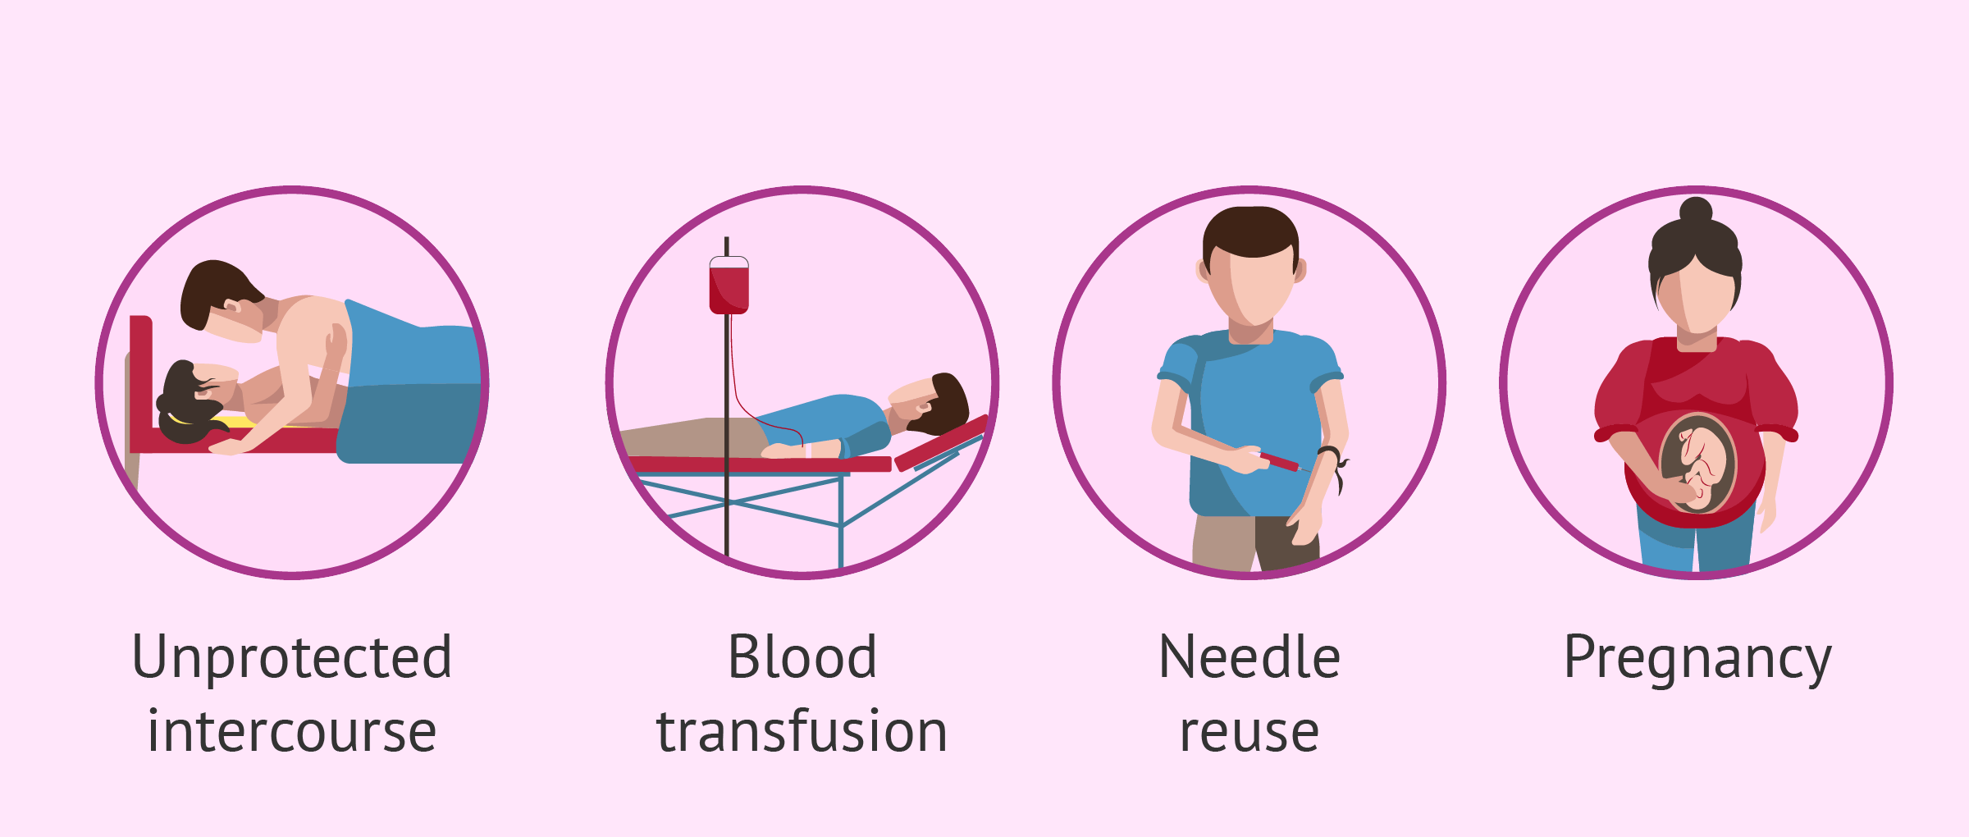
METHODS OF TRANSMISSION: High-Risk (pg. 18)
Sexual Intercourse
  vaginal
  anal
  oral
Blood-to-blood contact or blood infusion
Sharing needles or other drug-use equipment
Tattoo or body piercing
Infected mother to her baby

Slide 77
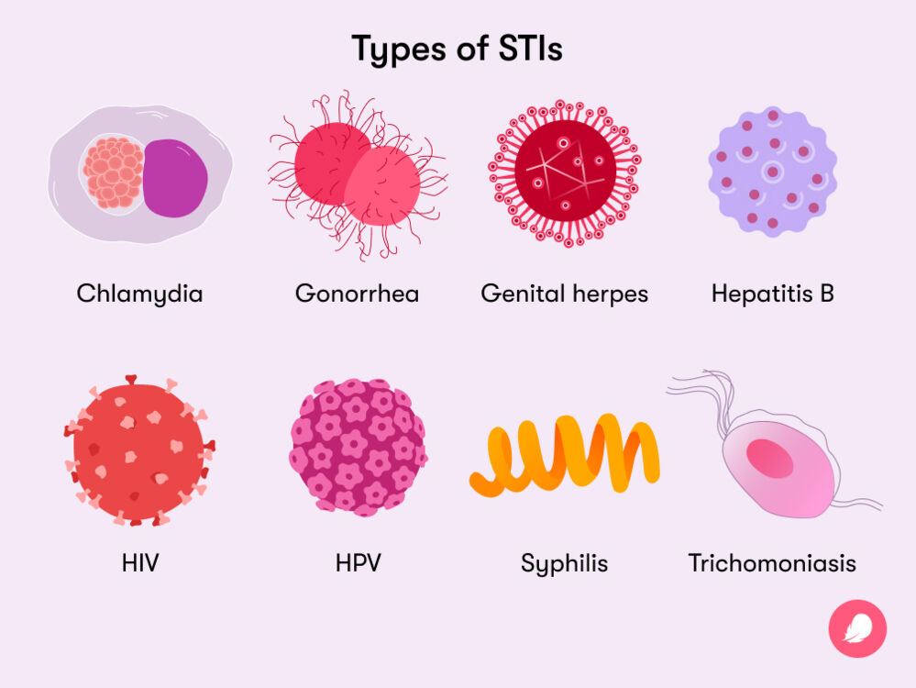
TYPES of STI’s: (pg. 19)
BACTERIAL – an infection caused by a bacteria.
    Treatable and curable with antibiotics.
    If untreated can cause long term side-effects.
    Chlamydia (most common), Gonorrhoea (‘the clap’), Syphilis, Trichomoniasis.
VIRAL – an infection caused by a virus.
    Cannot be cured.
    Medication to treat symptoms only.
    Can pass onto others for the rest of your life.
    Human Papilomavirus (HPV), HIV/AIDS, Herpes Simplex Virus (HSV), Hepatitis B.
3. PARASITIC – an infection caused by a parasite.
    Can be cured/treated
    Public lice (crabs), Trichomoniasis, Scabies

Slide 78

WARNING: GRAPHIC CONTENT
Over the next collection of slides we will be going over the different types of STI’s – what they are, signs and symptoms, treatment etc.
Some slides will contain graphic images.
Use the information to write your own notes onto pg.20 in your books.
This information can be used later to assist you with your assignment.
Notes:
Over the next collection of slides a variety of STI’s will be shown. While following along, students can write their own notes into the space provided on pg.20 of their workbooks. The main purpose is to introduce them to the different STI’s and generate discussion. When students are presenting their assignments, the audience will need to complete a table about each different STI that is presented. By the end of the presentations, students will have collated more information on all the different STI’s into their workbooks.

Slide 79
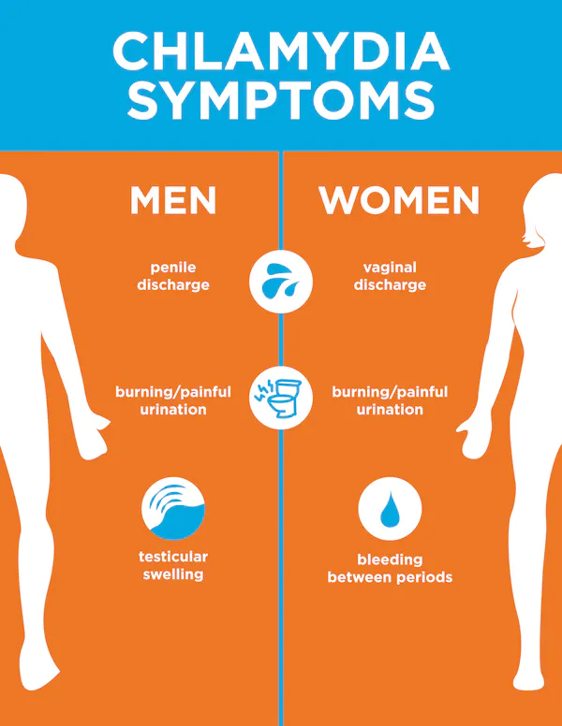
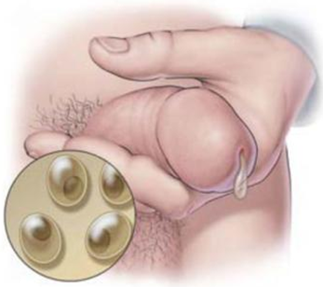
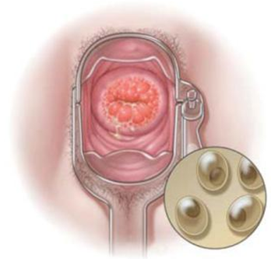
Chlamydia
Among the most common bacterial STIs in the world. In WA, most common in people <25 years.
Passed by having unprotected oral, anal or vaginal sex.
Condoms can help prevent the spread of chlamydia.
Most people have no symptoms.
The infection can be cured with a single dose of antibiotics.
If untreated it can affect the cervix, urethra, uterus, fallopian tubes,
rectum, throat, eye, and can cause ectopic pregnancy or infertility.
Remember Chlamydia is
CURABLE!

Slide 80


Gonorrhea
Second most common bacterial infection and is most common in 15-29 year-olds.
Passed along by having unprotected oral, anal or vaginal sex.
Condoms can help prevent the spread of gonorrhea.
Most people have no symptoms, especially in females.
The infection can be cured with antibiotics.
Female:
Vaginal discharge
Painful urination
Bleeding after sex
Bleeding between periods
Pain during sex
Lower abdominal pain
Male:
Thick, yellowish-green discharge from penis
Painful urination
Testicular pain or swelling
Rectal pain, discharge or itching.
Remember Gonorrhea is CURABLE!

Slide 81
Syphilis
Bacterial infection.
Can cause serious damage to the body if not cured.
Passed along by having unprotected oral, anal or vaginal sex.
Condoms can help prevent the spread of syphilis.
The infection can be cured with antibiotics.
There are 4 stages of syphilis infection: primary, secondary, latent and tertiary.
Symptoms vary depending on the stage.
Some people have no symptoms.
Stage 1 = Primary
  Small, painless sores
Stage 2 = Secondary
  Rash, hair loss, feeling sick, weight loss, muscle aches
Stage 3 = Latent
  Lesions or rashes can recur but there may also be no visible signs or symptoms
Stage 4 = Tertiary
  Can affect heart, blood vessels, brain, nervous system
  Would occur 10-30 years after initial infection
  Can result in death
Remember Syphilis is CURABLE!
Notes:
Syphillis Can spread from an infected mother to her unborn child

Slide 82









Primary Stage:
Secondary Stage:
Notes:
Primary Syphilis: a painless open sore which heals on it’s own, but the infection remains

Slide 83
Herpes Simplex Virus (HSV 1 + 2)
Two types of Herpes Simplex Virus (HSV).
    HSV 1 = causing cold sores
    HSV 2 = causes genital herpes
Viral infection causing outbreaks of painful sores and blisters.
Passed along by having unprotected oral, anal or vaginal sex with an infected partner, or kissing.
There is NO cure.
Symptoms can be managed with medication.
Virus can lay dormant in your body and recur at different times.
Signs & Symptoms:
  Prior to an outbreak, the person may feel a tingling or burning sensation where the virus first entered the skin
  Painful sores (external or internal)
  Inflammation and redness
  Fever
  Muscular pain
  Tender lymph nodes

Slide 84




HSV 1
HSV 2 (genital)

Slide 85
Human Papilomavirus (HPV) / Genital Warts
Viral infection.
Spread through skin-to–skin contact, even if there are no symptoms, or through unprotected vaginal, anal or oral sex.
Can also be passed from mother to baby during childbirth.
Many different types – some can cause warts (non-cancerous), and some can cause cancers.
Sometimes there are no symptoms, other times it causes genital warts, pain during sex, itchiness or painless warts.
Vaccine available.
Warts treatment can include freezing, cutting, burning or zapping.
Notes:
HPV can cause cervical cancer, anal cancer, vaginal cancer, throat cancer, vulva cancer, penile cancer.
Vaccine available for the type that causes most genital warts, 90% of cervical cancers and 95% of other HPV related cancers.

Slide 86



Human Papilomavirus (HPV) / Genital Warts
Notes:
HPV can cause cervical cancer, anal cancer, vaginal cancer, throat cancer, vulva cancer, penile cancer.
Vaccine available for the type that causes most genital warts, 90% of cervical cancers and 95% of other HPV related cancers.

Slide 87

HIV / AIDS
HIV is a viral infection that, over time, leads to the development of AIDS.
  HIV = Human Immunodeficiency Virus
  AIDS = Acquired Immunodeficiency Syndrome
It attacks the immune system.
No cure – once acquired, the person has it for life. With proper care, HIV can be controlled.
Some people have no symptoms at all, but symptoms can include flu-like symptoms.
The only way to know is to get tested.
HIV is contained in the blood, semen, vaginal fluid and breast milk of an infected person.
Can be spread via unprotected vaginal or anal sex, sharing drug equipment, sharing needles (i.e., tattoos and piercing), transmission from mother to baby, accidental sharps (needle) injuries.
Notes:
Spread initially from chimpanzees when Africans used to hunt them and would come into contact with their infected blood.

Slide 88
Hepatitis B
Hepatitis B is an STI and blood-borne virus (BBV)
Can be passed on through unprotected sexual contact or by blood-to-blood contact (i.e., sharing drug use equipment and needles) or from pregnant mother to baby.
Virus that attacks the liver.
Symptoms include: fever, fatigue, muscle aches, swollen glands, abdominal pains, jaundice, nausea/vomiting, dark yellow urine, pale or grey poo.
Most infected people (90%) naturally produce antibodies to fight the disease, but some develop chronic HBV and will carry the virus for the rest of their life.
Chronic infection can lead to liver damage, cirrhosis, and cancer and has no cure.
Antiviral treatment.
Vaccination available.

Slide 89



Parasitic STI’s
Pubic Lice
Trichomoniasis
Scabies
The lice attach their eggs to the pubic hair and feed on human blood
Caused by a parasite that is usually sexually transmitted, but it can survive 24 hours on wet towels and bathing suits
Caused by the itch mite. It burrows just under the skin and lays eggs. Can live for 2-4 days away from the human body; it can be transmitted without sexual contact.
Notes:
Spread by sexual contact. Not the same as head lice. Pubic lice do not live on the head and head lice do not live in the pubic area.

Slide 90



Parasitic STI Symptoms

Slide 91



PARASITIC STI Prevention & Treatment
Trichomoniasis
Condoms will help prevent the spread.
Treated with antibiotics.
Pubic lice and Scabies
Avoid sharing towels and clothing that have not been washed.
When trying on bathing suits or underwear in the store always wear something underneath.
Treated with shampoo, lotion or ointment.
Notes:
Trichomoniasis ( trich-o-mo-ni-a-sis) or Trich

Slide 92

Viral STI’s
Herpes
HPV
HIV
Notes:
OPTIONAL ACTIVITY
7:09mins
https://www.youtube.com/watch?v=e6MNzZn4W0w

Slide 93

STI’s are dangerous because…
Common
Can be serious, particularly if left untreated (discomfort, disease, infertility, death)
Not many preventative vaccines (only 2)
Some are incurable
Many have no signs/symptoms
Most spread silently
Notes:
Included in their books (pg.18)

Slide 94
Optional Activity: Condom Activity
Using the condom resources, allow students time to practice how to use condoms.

Slide 95
CONTRACEPTION & STI’s
Year 10 Health Lesson 6 Term 2, 2024

Slide 96
Today’s Focus
Consider your own values regarding your own sexual health.
Discuss barriers to getting tested
STI’s task – allocate groups and start working

Slide 97
Activity 1: values walk around
Placed around the room are response cards
Strongly Agree → Strongly Disagree
Your teacher will read out a statement and you need to decide how you feel about it and move to the card that best describes how you feel.
When doing this activity, really think about WHY you feel that way.
Be prepared to share your response and reasoning.
Notes:
Resources = Response cards (available in Health Storeroom) and blutack.
Place STRONGLY AGREE, AGREE, NEUTRAL, DISAGREE, STRONGLY DISAGREE cards around the room.
Read the statement out to students.
Give them 20 seconds to move to the card that best describes their response to the statement.
Ask students why they feel the way they feel.
This activity allows students to consider their values when it comes to relationships and sexual relationships.
You can use the statements on the following slides OR read them out from a piece of paper.

Slide 98
Values Statements:
It is mainly the boy's responsibility to buy condoms.
Teens who abstain from sex are less likely to be emotionally harmed.
Teens who abstain from sex are less likely to be physically harmed.
If you can’t talk with your partner about sex or contraception ahead of time, then you shouldn’t even consider having sex.
I would not buy condoms from a store where I might know someone.
Having sex without using contraception for the first one or two times is OK because the chances of getting pregnant are minimal.
Notes:
Read out the statement. Allow students 20 seconds to move to the appropriate card that describes their response. Encourage students to discuss and share their answers.

Slide 99

Prevention (pg. 21)
STI’s can only be 100% prevented by being abstinent (not engaging in sexual behaviours).
The only methods of contraception that protect against STI’s are condoms. But why?
Choose sexual partners wisely – the more sexual partners a person has, the higher the risk of contracting an STI.
Get tested regularly.
Avoid alcohol/drugs when engaging in sexual behaviours so you have a clear mind and can consider all associated risks, and don’t share needles.
Learn the signs/symptoms – this can help with early diagnosis and prevent further spread.
HPV and Hepatitis have effective vaccines available.
Notes:
Image is included in their books with space to complete the headings under neath each tip.

Slide 100
Diagnosis & TREATMENT (pg. 22)
A person should abstain from sexual behaviours if they believe they may have an STI, are currently being treated, or awaiting test results.
STI’s can be diagnosed through a variety of methods including:
  Urine sample
  Blood test
  Swab test
The type of STI being tested for determines the diagnosis method used.
Treatment varies depending on the STI:
  Viral – cannot be cured but medication may be available to treat the symptoms.
  Bacterial – can be cured/treated with antibiotics.
  Parasitic - through medication, creams, shampoos, lotions or ointments.
If diagnosed with an STI, it is important to inform your sexual partners.
www.letthemknow.org.au is an anonymous notification service.

Slide 101

When should a person Get tested? (pg. 22)
Yearly, once becoming sexually active.
Have engaged in unprotected sexual intercourse or the condom broke.
Partner has an STI.
Partner is having sex with someone else.
Have ever injected drugs.
You or partner have any STI symptoms.
Have been a victim of sexual assault (i.e., rape).

Slide 102

Barriers to getting tested:
(pg. 23)
Have a group discussion about what you believe would prevent/stop a person from getting tested for an STI.
You have 90 seconds to discuss.
Be prepared to share your thoughts.

Slide 103
Barriers to getting tested:
(pg. 23)
Don’t know where to go for help or testing.
Costs time and money.
Inconvenient.
Perception that it ‘won’t happen to me’.
Fear of a positive result.
Lack of knowledge of signs/symptoms.
Associated stigma, embarrassment or shame.
Notes:
Students add these to their books.

Slide 104

Big spike in no. of Chlamydia notifications from 1999 - 2017.
Steady decline of Hep C.
Hep B remains steady.
HIV has seen no notable increase <1997.
Spike in Gonorrhoea since 2009.
Spike in Syphilis from 2013.
What’s trending?
Notes:
Ask students what trends they can idenifty from the graph about STI rates from 1996-2017.

Slide 105
Statistics:
About 16% of Australians have had an STI in their lifetime.
In 2020, more than 29,000 Australians were living with HIV (an 18% drop of HIV notifications since 2015).
In 2020, there were about 57,500 new cases of notifiable STI among females and 67,400 among males
In Australia between approx. 2013-2023:
  Gonorrhoea cases have doubled
  Syphilis cases have more than tripled
  Chlamydia cases have increased 12% since 2013
In Australia in 2022:
  93,777 diagnoses of Chlamydia (still often undiagnosed)
    most common STI, with more than 2 in 3 diagnoses occurring in 15-29 year-olds.
  32,877 diagnoses of Gonorrhoea
  6036 diagnoses of Syphilis
Notes:
https://www.kirby.unsw.edu.au/news/sexually-transmissible-infections-are-rise-australia-syphilis-rates-tripling-over-decade#:~:text=Early%20testing%2C%20diagnosis%2C%20and%20treatment,6%2C036%20diagnoses%20of%20infectious%20syphilis.

Slide 106
Assignments: Task 3
STI Oral Presentation (pg. 4-6)
You may work in groups of 2, 3 or 4 (max). Each group will be allocated a different STI to research and present on.
While groups are presenting, the audience will have a worksheet/table to fill out. By the end of all the presentations you will have a collection of information on all the different STI’s.
All assignments will be due by Week 9 (regardless of when you are presenting).
Each group member needs to talk during the presentation.
Four parts to the task: PowerPoint → Brochure → Presentation → Individual Group Reflection (all due week 9).

Slide 107

Presentation skills:
Q: What do you like and expect to see and experience when you are watching someone give a presentation?
Eye contact
Clearly spoken
Engaging tone of voice
Engaging content
Activities
Pictures and/or videos
Relevant information
Notes:
Ask students to contribute their answers.
Think about this when creating their own presentation and make it as engaging and entertaining as possible.

Slide 108
Presentation options:
You MUST have an oral presentation component in front of the class on the day and each group member is expected to speak.
What could you include in your presentation to make it engaging and entertaining?
How could you present your oral presentation?
Speech
Role Play
Rap or song
Videos
Etc.
Images and videos
Activities
Quizzes
Music
Etc.

Slide 109
STI’s:
Chlamydia
Syphilis
Gonorrhoea
Human Papilomavirus (HPV) / Genital Warts
Herpes Simplex Virus (HSV) & Genital Herpes
Scabies/Pubic Lice (crabs)
Trichomoniasis
Hepatitis A & B
HIV/AIDS
Notes:
Allocate one group to a different STI.
When students are presenting their assignments, the audience will need to complete a table about each different STI that is presented. By the end of the presentations, students will have collated information on all the different STI’s into their workbooks.

Slide 110
CONTRACEPTION & STI’s
Year 10 Health Lesson 7 + Lesson 8 Term 2, 2024

Slide 111
Today’s Focus
Complete Task 3: STI Oral Presentation.
**Week 7 = exam break**

Slide 112
CONTRACEPTION & STI’s
Year 10 Health Lesson 9 Term 2, 2024

Slide 113
Today’s Focus
Task 3: Presentations - DUE TODAY
+ complete table as listening.

Slide 114

STI Presentations:
(pg. 26-27)
Complete the table in your books while listening to other groups present their work.
By the end of the presentations, you will have collected information different types of STI’s.
Notes:
When students are presenting their assignments, the audience will need to complete a table about each different STI that is presented. By the end of the presentations, students will have collated information on all the different STI’s into their workbooks.

Slide 115
CONTRACEPTION & STI’s
Year 10 Health Lesson 10 Term 2, 2024

Slide 116
Today’s Focus
Task 3: Presentations.
+ complete table as listening.

Slide 117
STI Presentations:
(pg. 26-27)
Complete the table in your books while listening to other groups present their work.
By the end of the presentations, you will have collected information different types of STI’s.
Notes:
When students are presenting their assignments, the audience will need to complete a table about each different STI that is presented. By the end of the presentations, students will have collated information on all the different STI’s into their workbooks.

Slide 118
CONTRACEPTION & STI’s
Year 10 Health Lesson 11 Term 2, 2024

Slide 119
Today’s Focus
Task 3: Presentations.
+ complete table as listening.
Investigate online help seeking resources.
Review content learned throughout term 2.

Slide 120
STI Presentations:
(pg. 26-27)
Complete the table in your books while listening to other groups present their work.
By the end of the presentations, you will have collected information different types of STI’s.
Notes:
When students are presenting their assignments, the audience will need to complete a table about each different STI that is presented. By the end of the presentations, students will have collated information on all the different STI’s into their workbooks.

Slide 121

Activity 1: Sexual Health – Where to go for help? (pg. 24-25)
By the end of this activity, you will come away with information on 4 different websites or locations you can go to for sexual health advice.
Working in small groups of no more than 4.
Each person is to choose a different website or resource from the list below.
Investigate the different websites you can visit for sexual health and STI advice.
Each person in your group investigates a different source.
You will have 6 minutes to research and complete the table in your book.
You will then present and share your research with your group members and everyone else will fill in your information into their books.
Notes:
OPTIONAL ACTIVITY IF ALL PRESENTATIONS ARE COMPLETED.
ALTERNATIVE
Allow students approx. 10-15mins for students to research 4 resources of their choice (skip the sharing/group work).

Slide 122







ACTIVITY 1: HELP RESOURCES (pg. 24-25)
WA Gov: Healthy Sexual – https://healthysexual.com.au/
Sexual Health Quarters – https://shq.org.au/helpline/
Get The Facts – https://www.getthefacts.health.wa.gov.au/
Could I Have It? – https://www.couldihaveit.com.au/home
Sexual Assault Resource Centre (SARC) – https://www.kemh.health.wa.gov.au/Other-Services/SARC
Healthy WA STI Factsheets – https://www.healthywa.wa.gov.au/Articles/A_E/About-sexually-transmissible-infections-STIs
Western Australian Aids Council (WAAC) – https://www.waac.com.au/
Notes:
All of these links are included in their books.

Slide 123

Activity 2: Review – Contraception & STI’s KWL (pg. 9)
This term we have learnt about contraception and Sexually Transmitted Infections (STI’s).
In week 1 you completed the first two columns of the KWL:
  What do you already KNOW about contraception and STI’s?
  What do you WANT to know about contraception and STI’s?
In week 11 it is now time to complete the third column of the KWL:
  What have you LEARNED about contraception and STI’s?
4 minutes to complete

